Slide 1
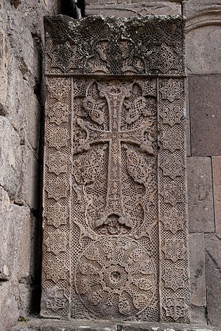
The famous khachkar at Goshavank, carved in 1291 by the artist Poghos.

Slide 2
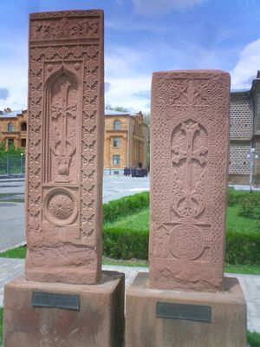
Two 16th century Julfa-type khachkars in Etchmiadzin, removed from the Julfa graveyard before its destruction by Azerbaijan.

Slide 3
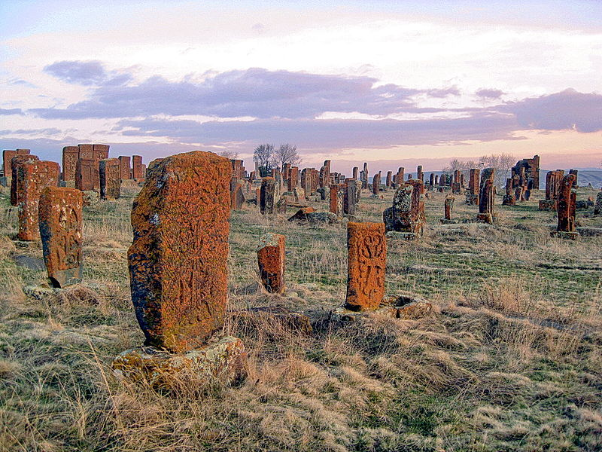
Khachkars appear in large numbers in the Noratus cemetery.

Slide 4
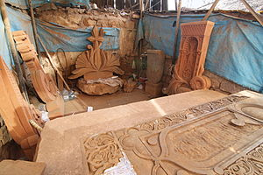
A modern-day khachkar carver's workshop in downtown Yerevan.

Slide 5
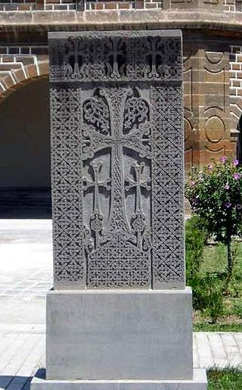
A khachkar behind the cathedral in Echmiadzin, Armenia. Place of origin is unknown.

Slide 6
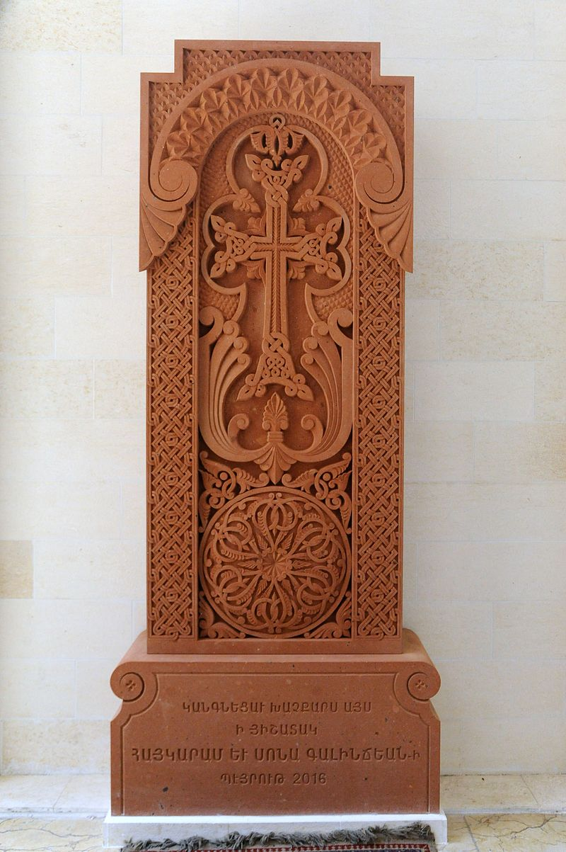
A modern khachkar at Sourp Kevork church- Beirut, Lebanon (2016)

Slide 7
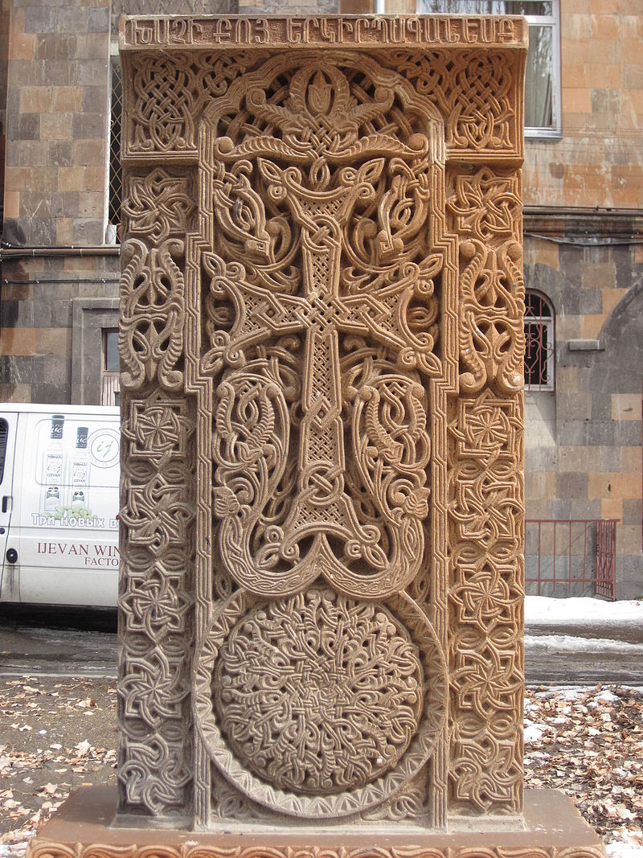
in Gyumri

Slide 8
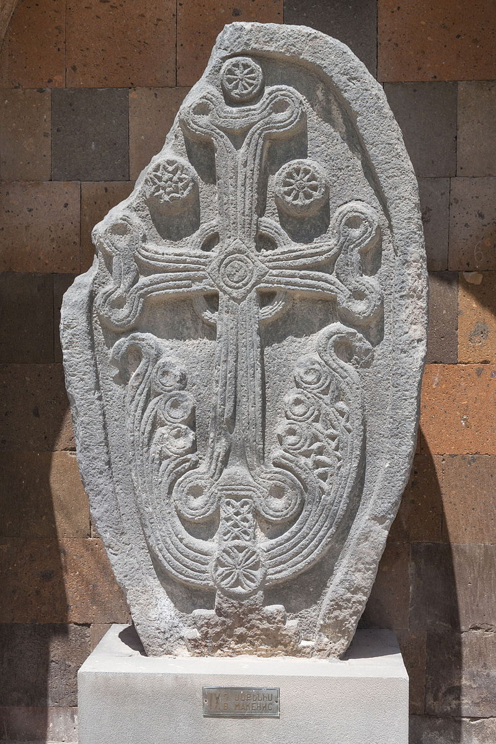
Khachkar from 996 from Cape Noratus. Vagharshapat, Armavir Province, Armenia

Slide 9
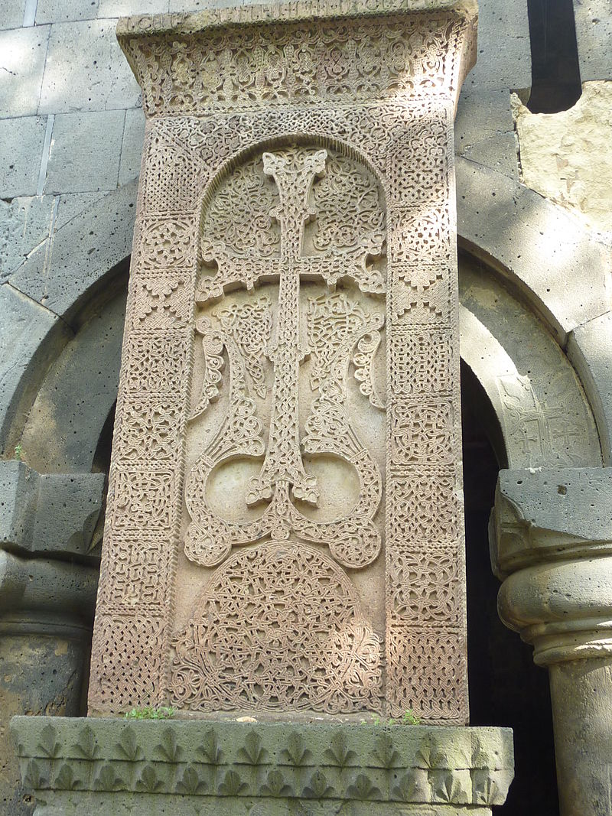
Monastère de Sanahin : khatchkar 3

Slide 10
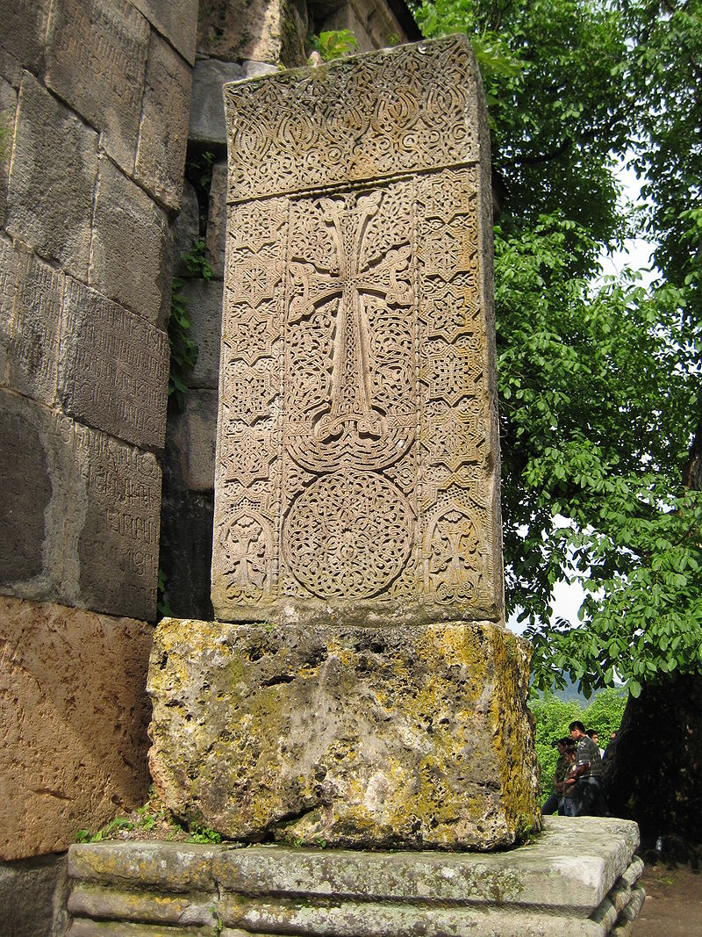
Khachkar at Haghartsin Monastery, near Dilijan, Armenia

Slide 11
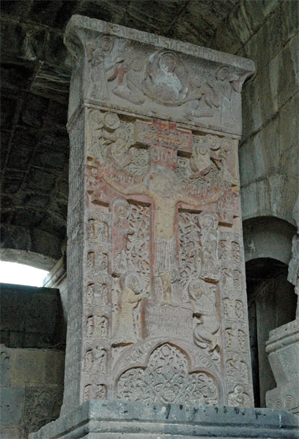
The Holy Savior khachkar in Haghpat (1273)

Slide 12
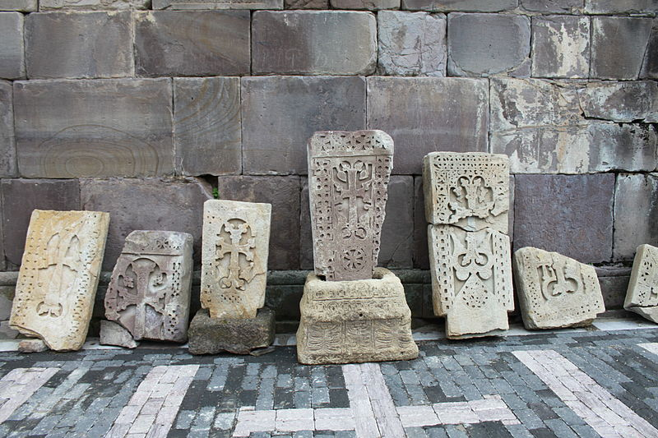
Various khachkars at Makaravank Monastery in Armenia

Slide 13
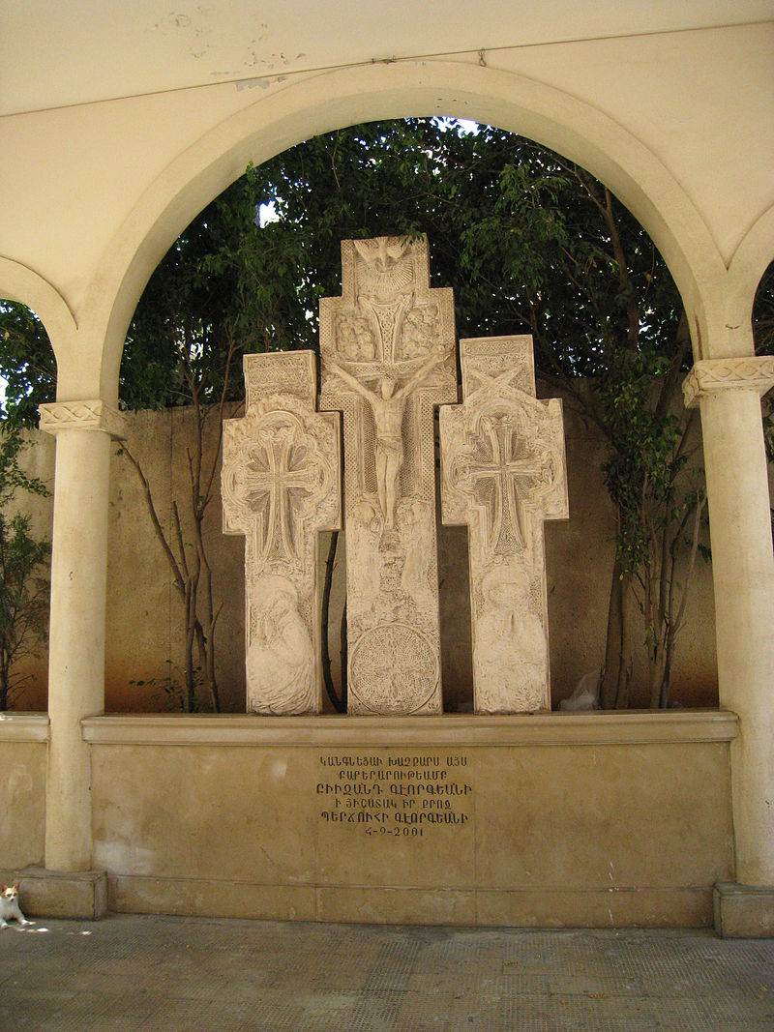
A modern Amenaprkich-type khatchkar with two others at the Sourp Nshan Church in downtown Beirut, Lebanon (2001)

Slide 14
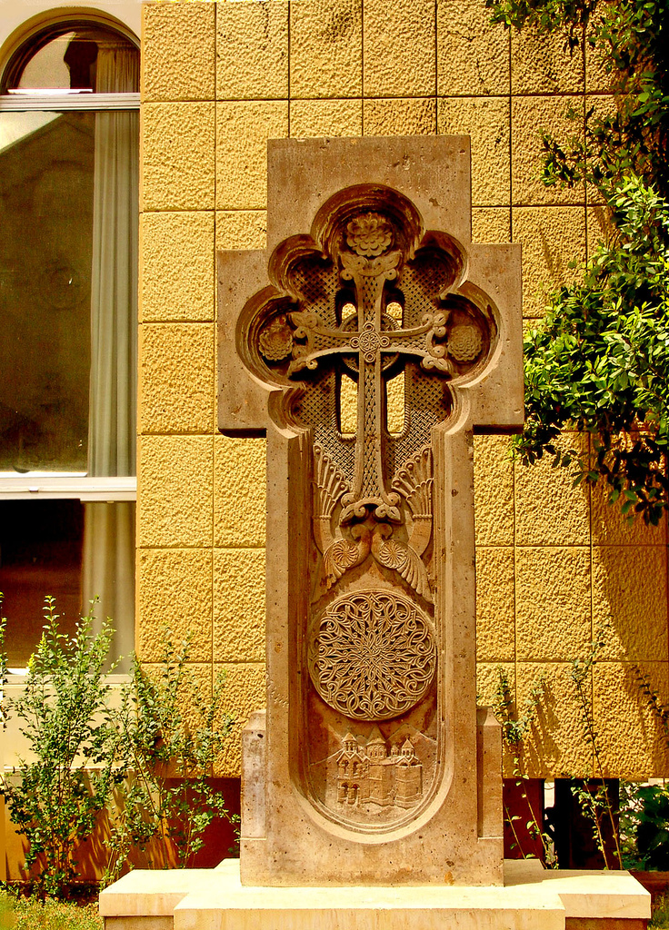
A modern khackhar at the Armenian Catholicossate of Cilicia in Antelias, Lebanon

Slide 15
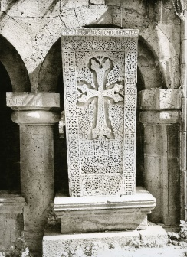
A khachkar in Sanahin

Slide 16
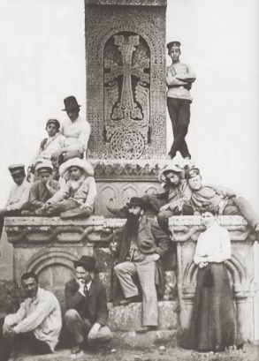
A monumental medieval khatchkar at the Armenian monastery of Sanahin in 1902

Slide 17
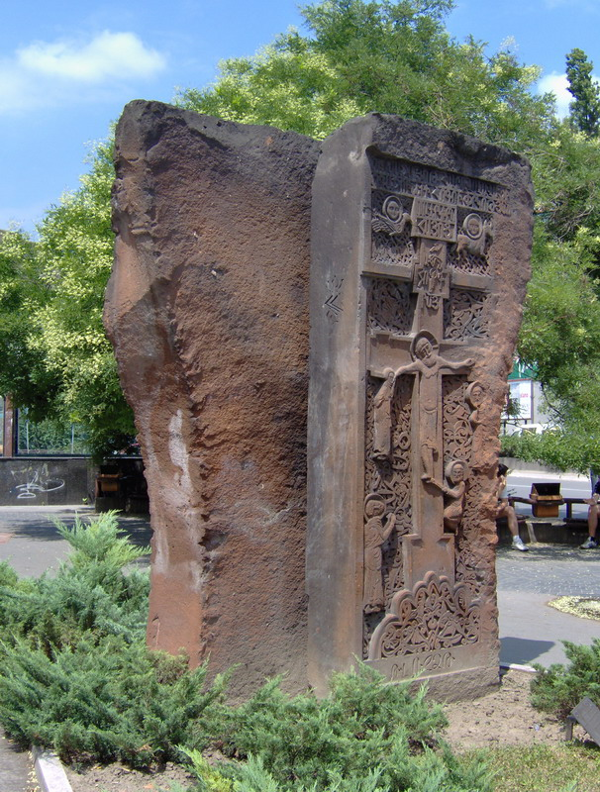
A modern, Amenaprkich-type, khachkar in Novi Sad, Serbia (1993)

Slide 18
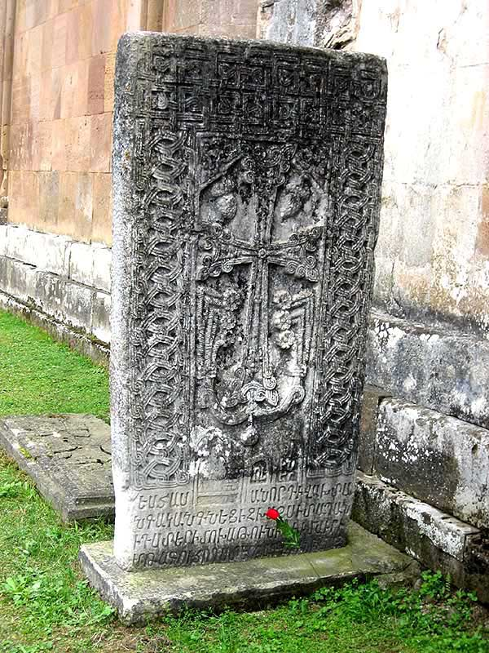
A large 13th-century khachkar at Gandzasar Monastery in Nagorno-Karabakh

Slide 19
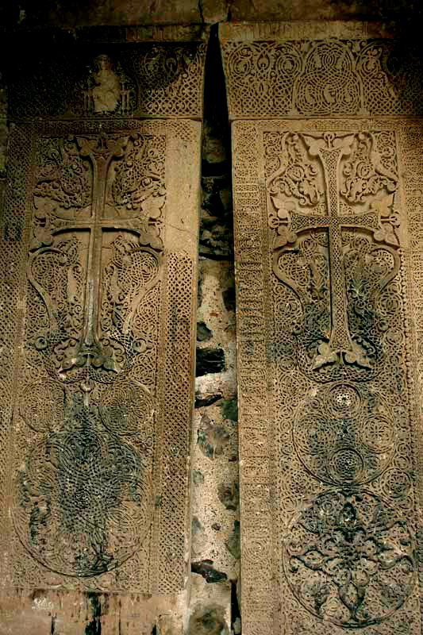
The famous double khachkars of the Memorial Bell-Tower of the Dadivank Monastery in Nagorno-Karabakh

Slide 20
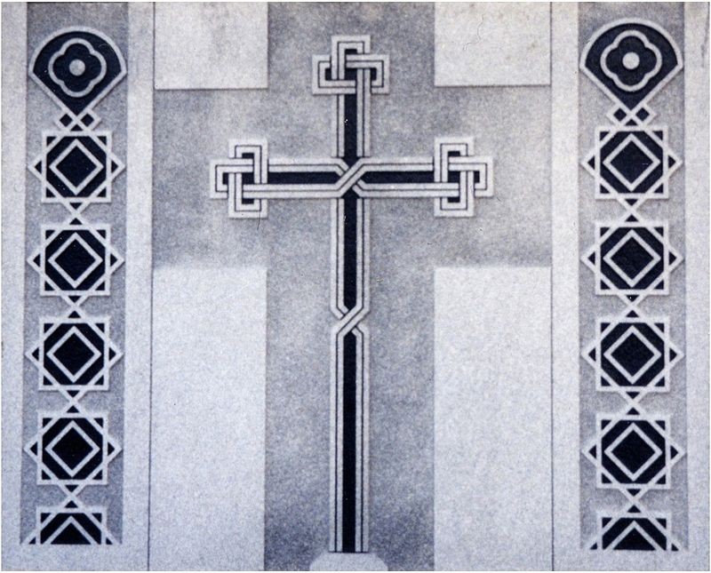
Modern khachkar (1999), St. James Armenian Church in Watertown, MA, USA

Slide 21
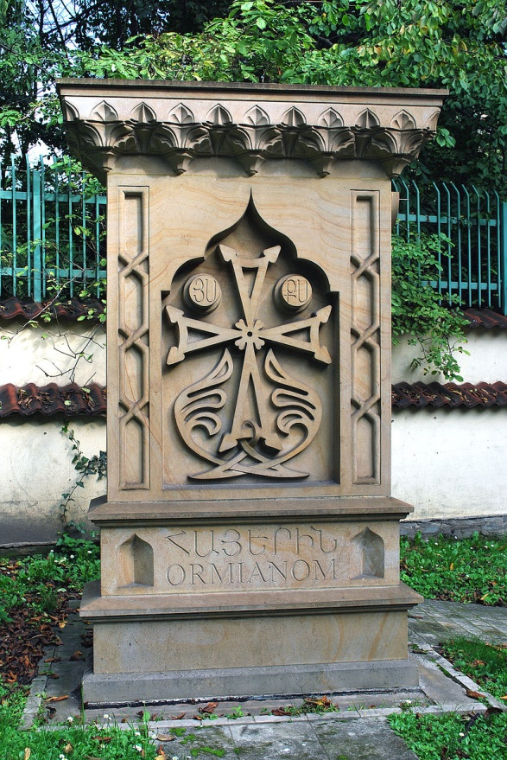
Modern khachkar (2004), Kraków, Poland

Slide 22
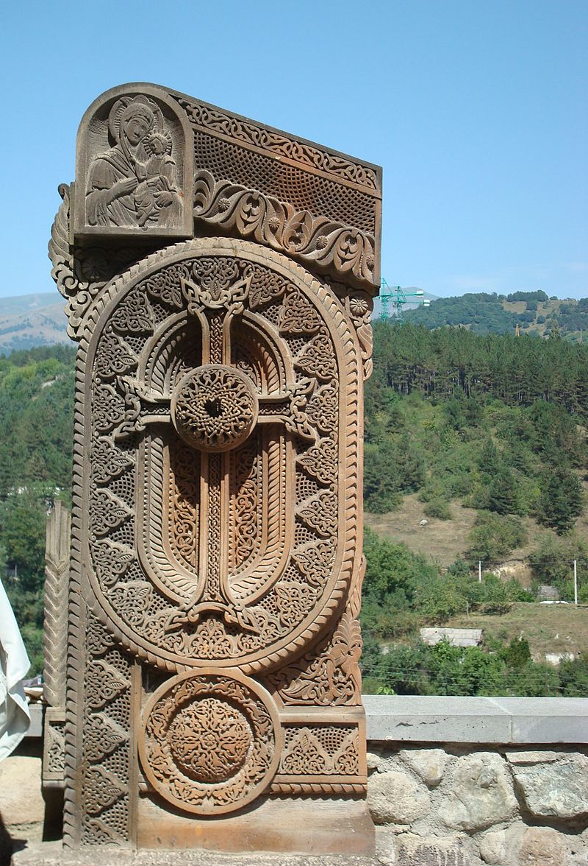
Modern khachkar at Goshavank

Slide 23
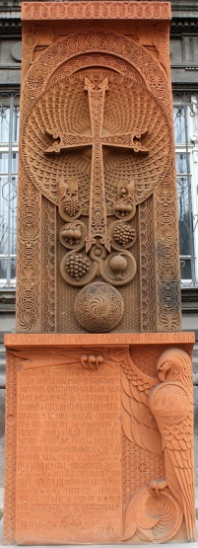
A modern khachkar with traditional Armenian symbolism in Yerevan

Slide 24
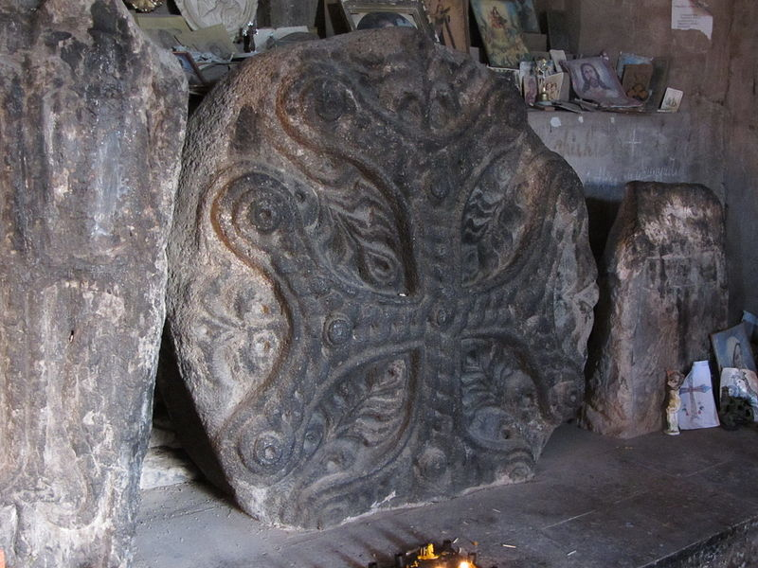
Talin, Kuys Sandukht Chapel, unique round cross-stone, 8th century
Armen Manukov - Own work

Slide 25
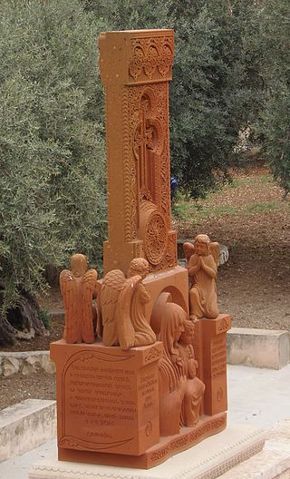
Modern khachkar outside the Tomb of Mary, Gethsemane, Jerusalem, installed in 2014 by the Armenian faithful.

Slide 26

Esempi di khachkar dalla città di Julfa, recentemente distrutti dall'Azerbaigian

Slide 27
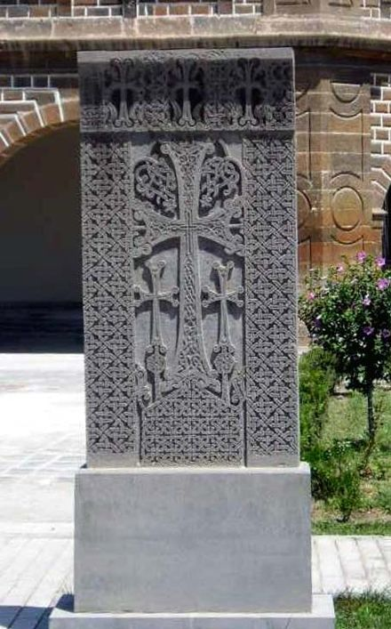
Un khachkar a Echmiadzin

Slide 28
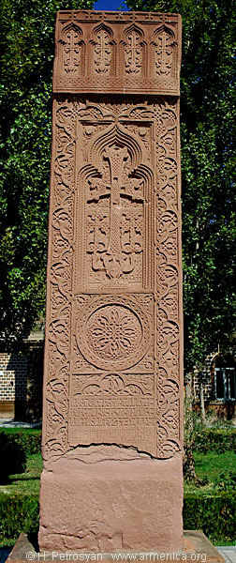

Slide 29
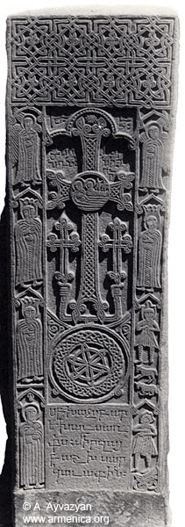

Slide 30
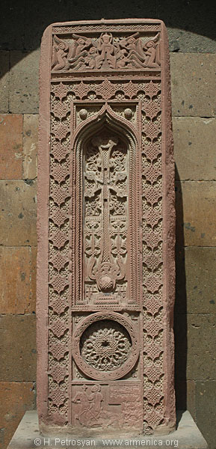

Slide 31
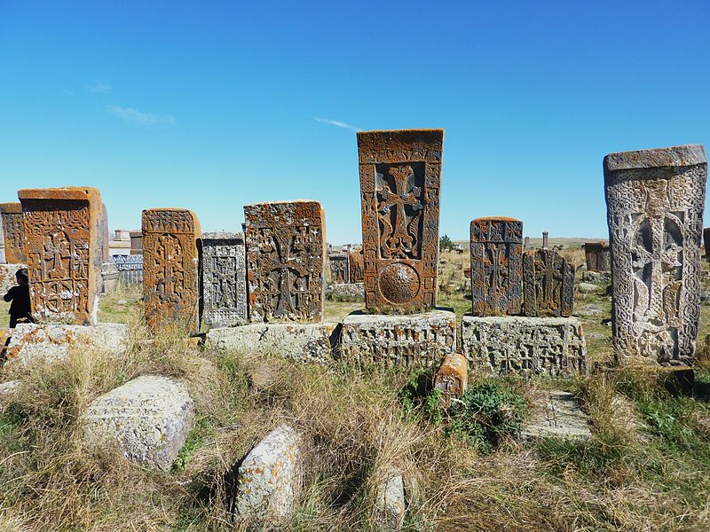
An ensemble of khachkars.

Slide 32
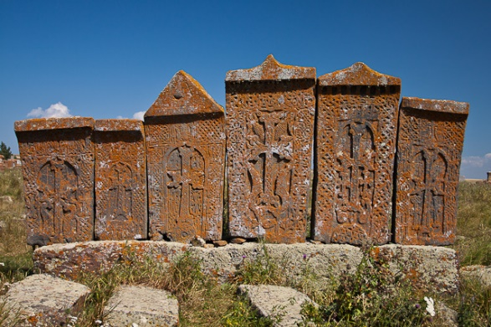
Noratus khachkars

Slide 33
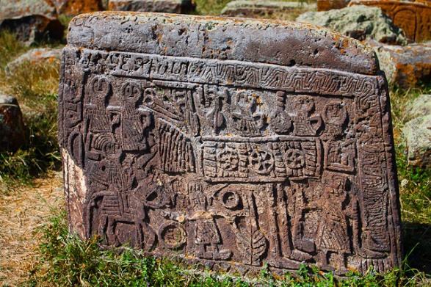
Tombstone depicting a wedding celebration

Slide 34
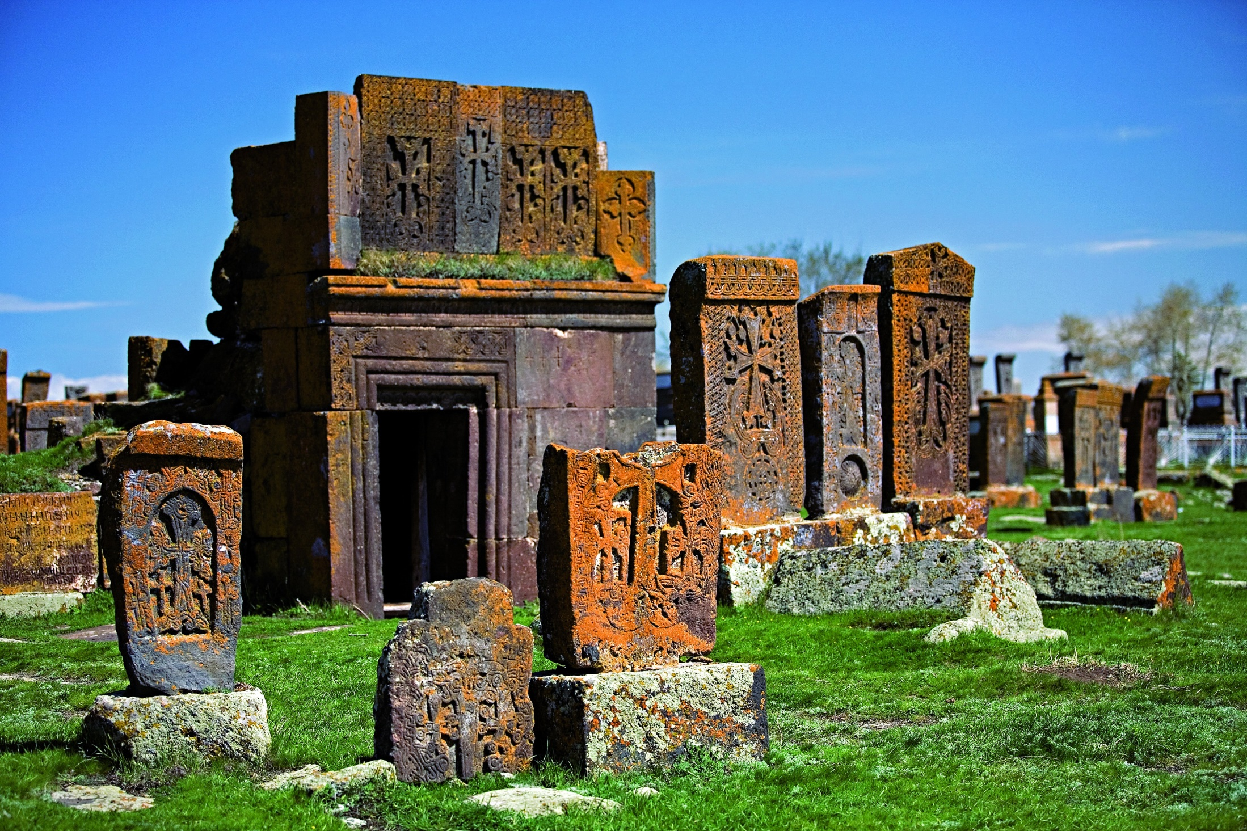
Khachkars and a tomb.

Slide 35
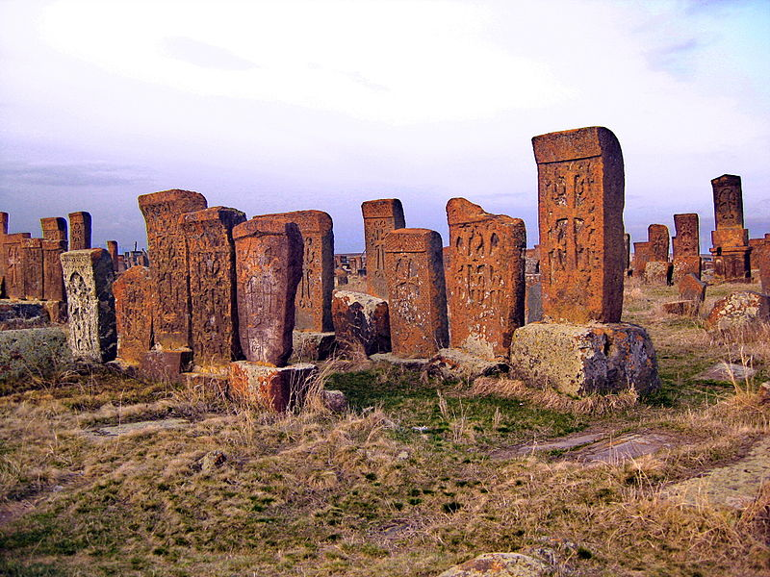
Khachkar complex in Noratus

Slide 36
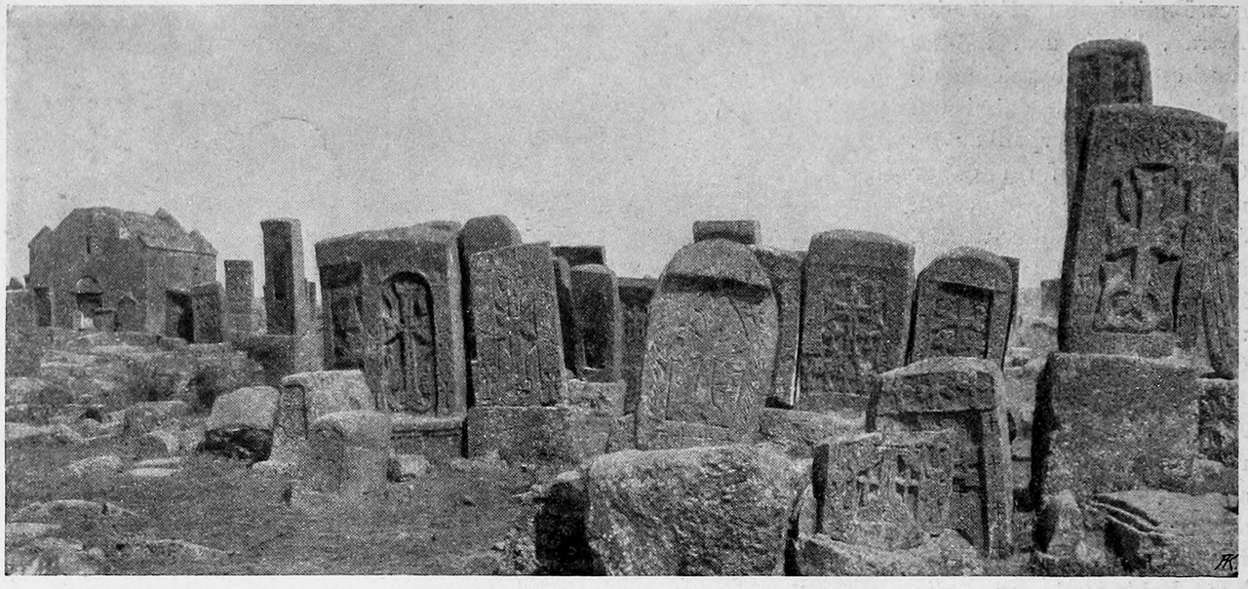
in the early 20th century

