Slide 1
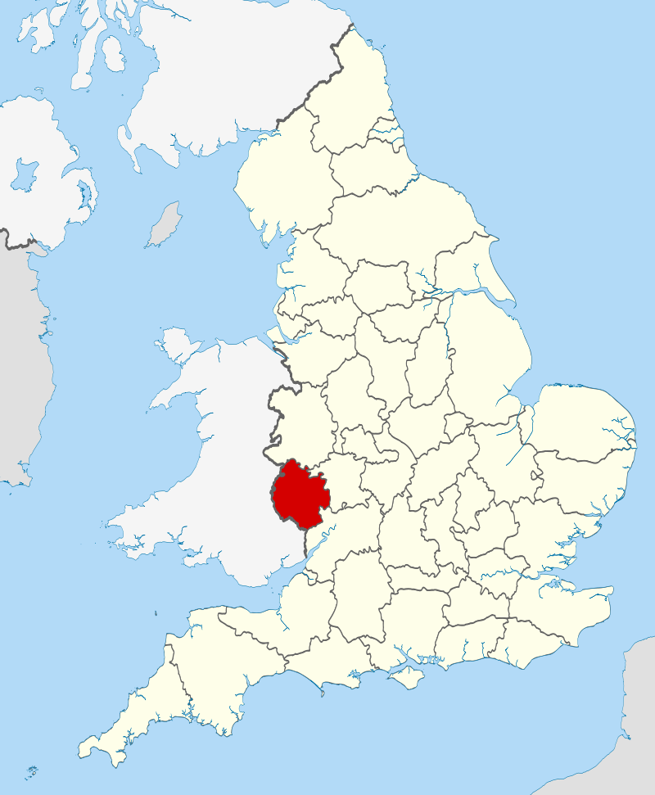
Location of the ceremonial county of Herefordshire within England.

Slide 2

The County Flag of Herefordshire, a modified banner of arms of Herefordshire County Council

Slide 3
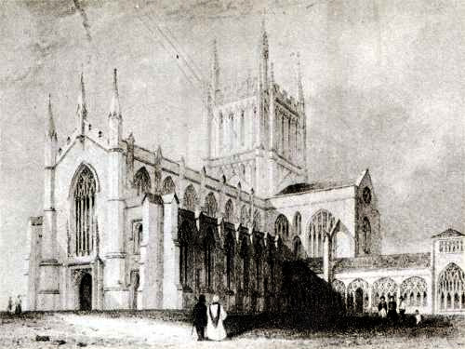
South West View featuring Wyatt's reconstruction with Cloisters (engraving)

Slide 4
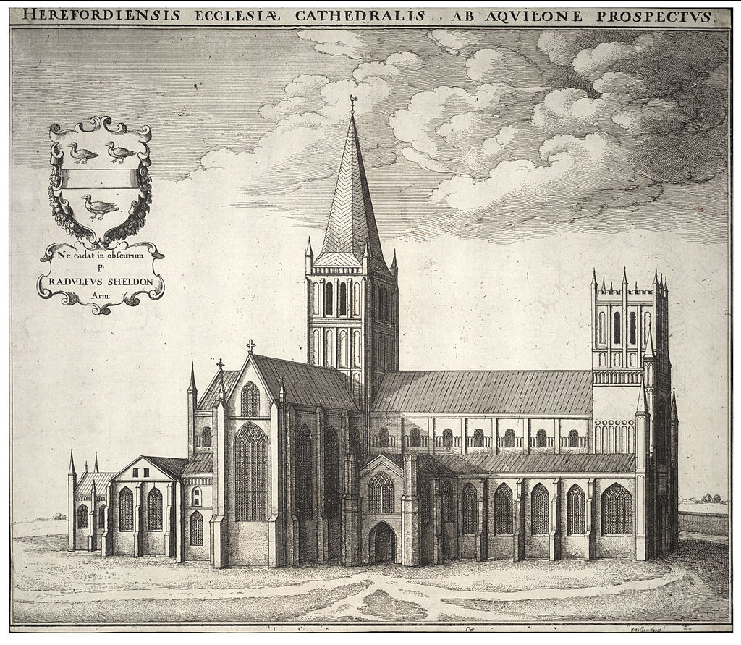
Wenceslas Hollar's engraving of the cathedral in the 17th century

Slide 5
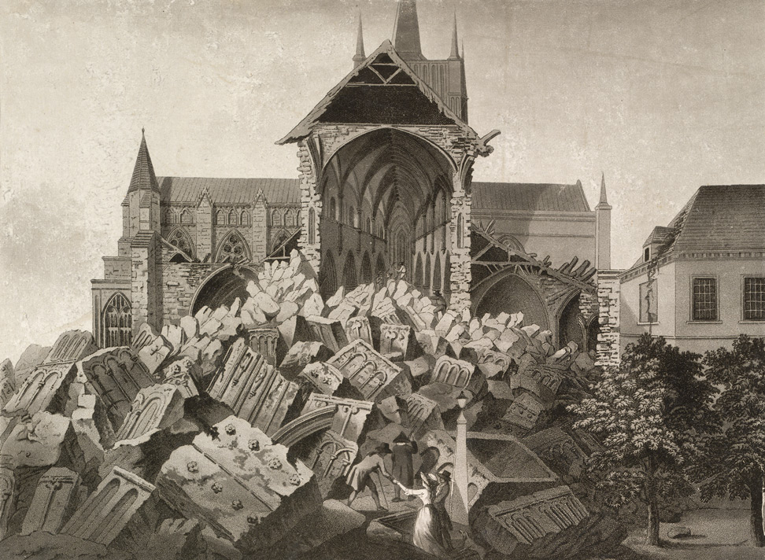
View of the Ruins of the West Tower of Hereford Cathedral, aquatint

Slide 6
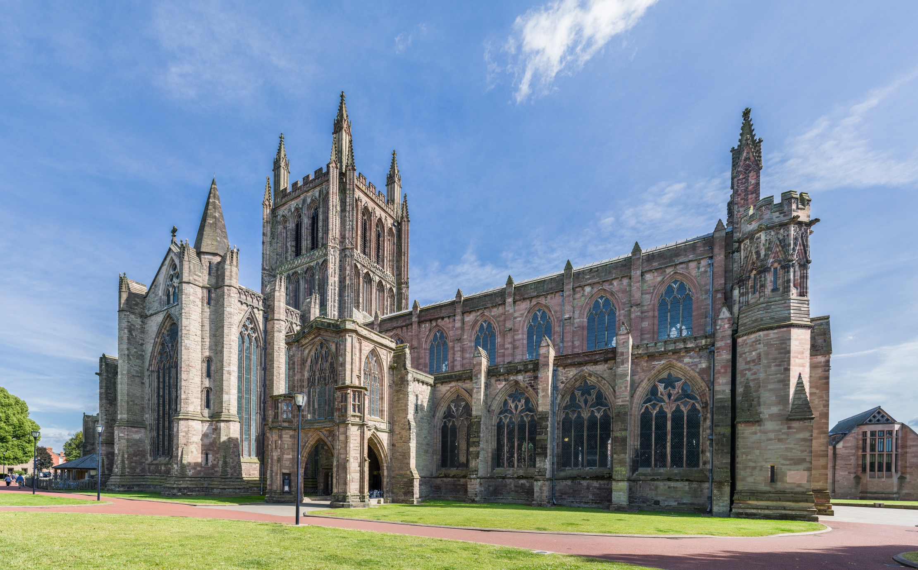
Hereford Cathedral as viewed from the north-west in Herefordshire, England

Slide 7

Hereford Cathedral from the north-west

Slide 8
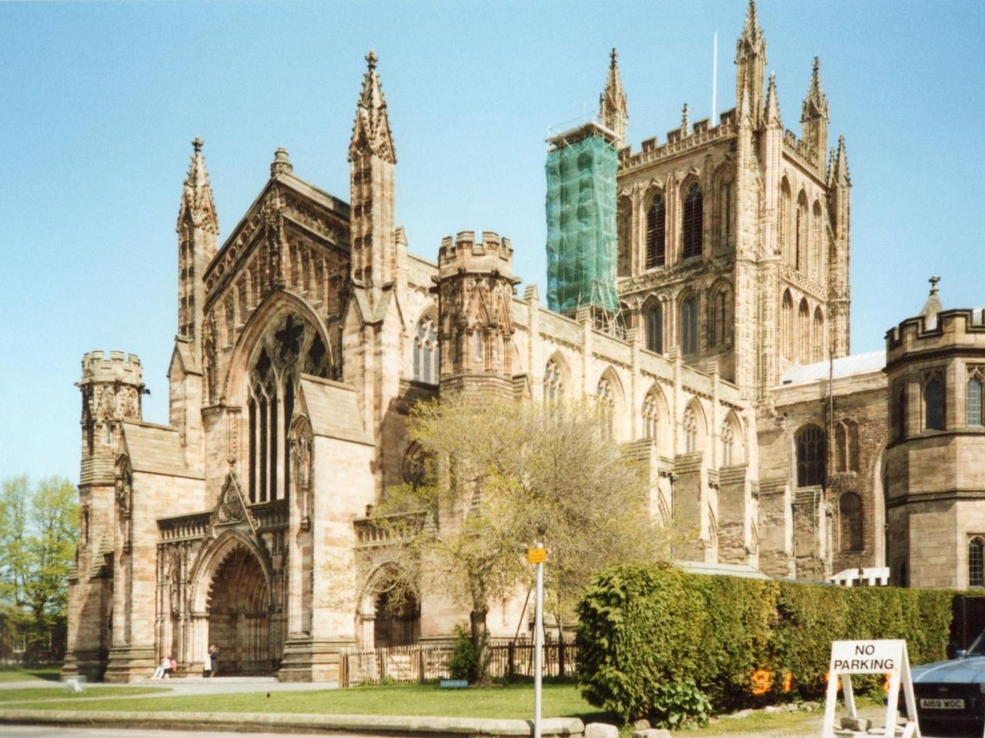
Hereford Cathedral

Slide 9
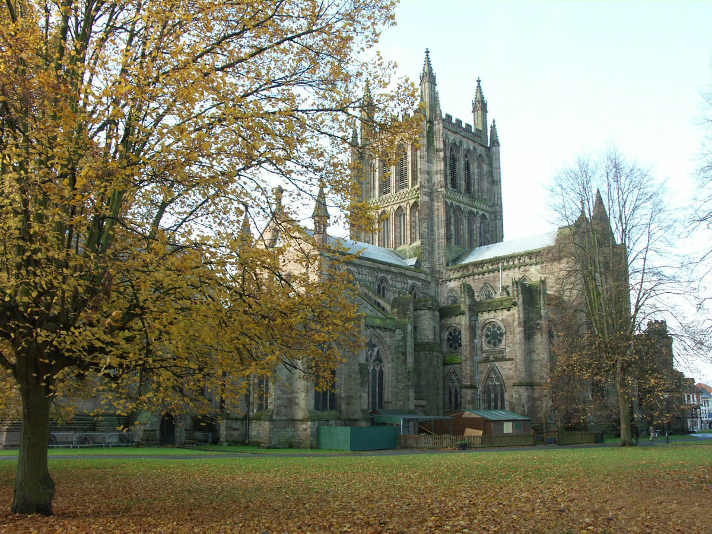
View from the north-east

Slide 10
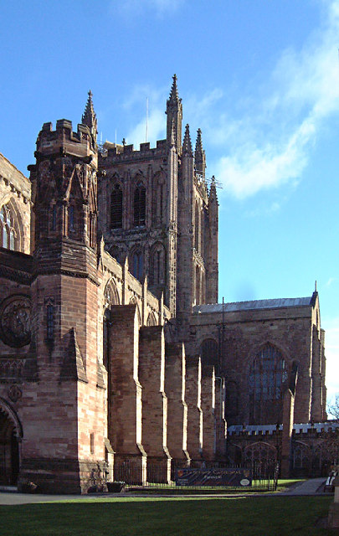
View from south-west

Slide 11
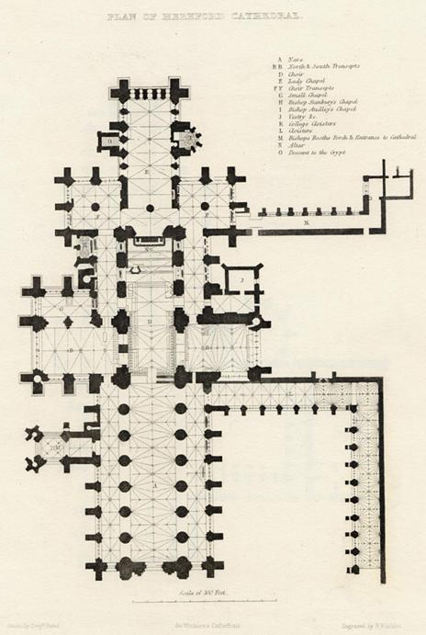
A plan of the Cathedral published in 1836.

Slide 12
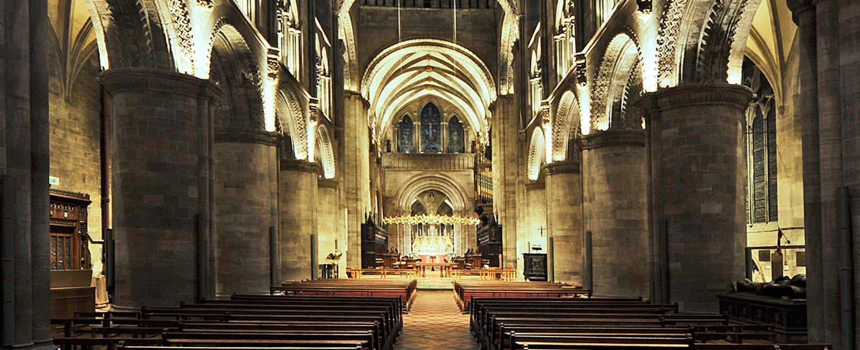

Slide 13
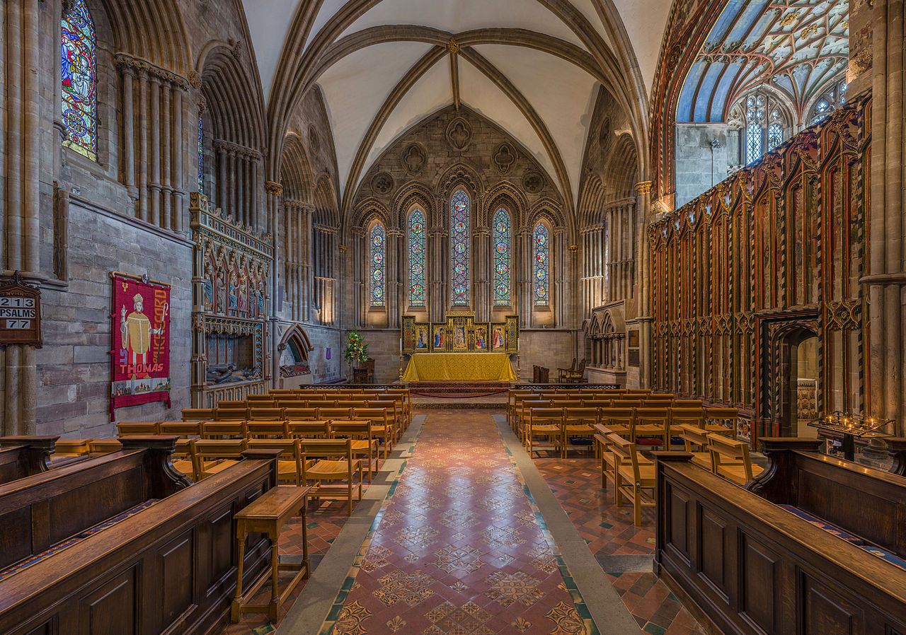
The Lady Chapel

Slide 14
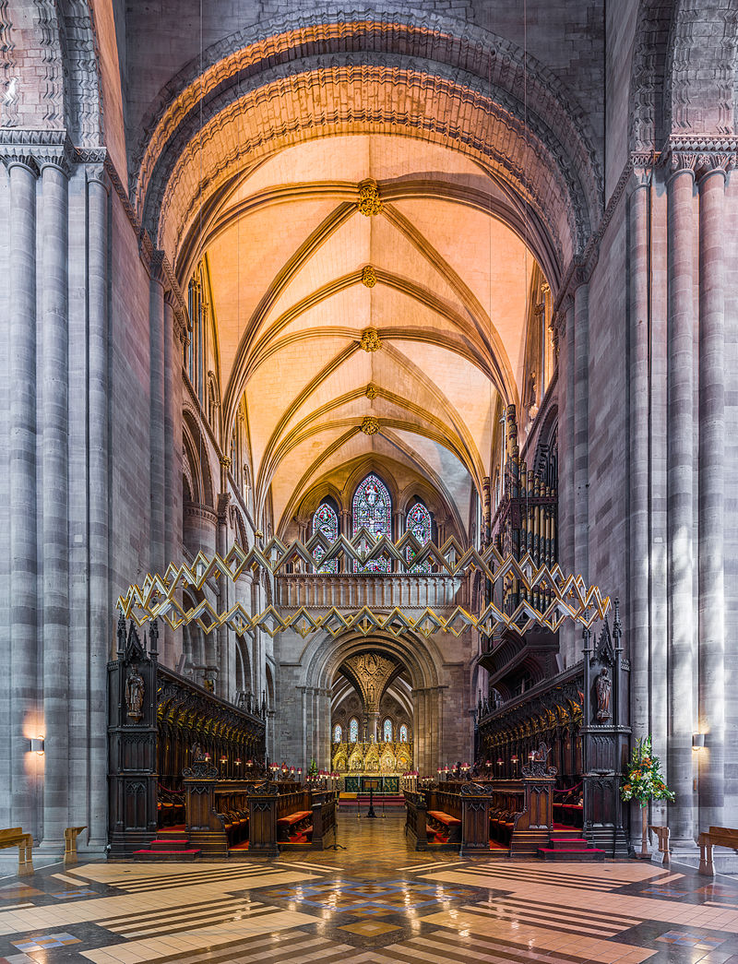
The choir

Slide 15
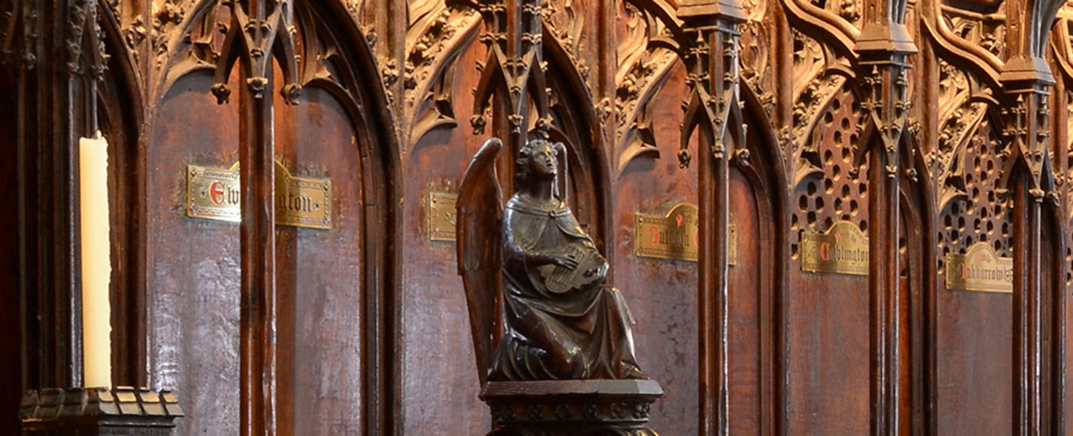

Slide 16
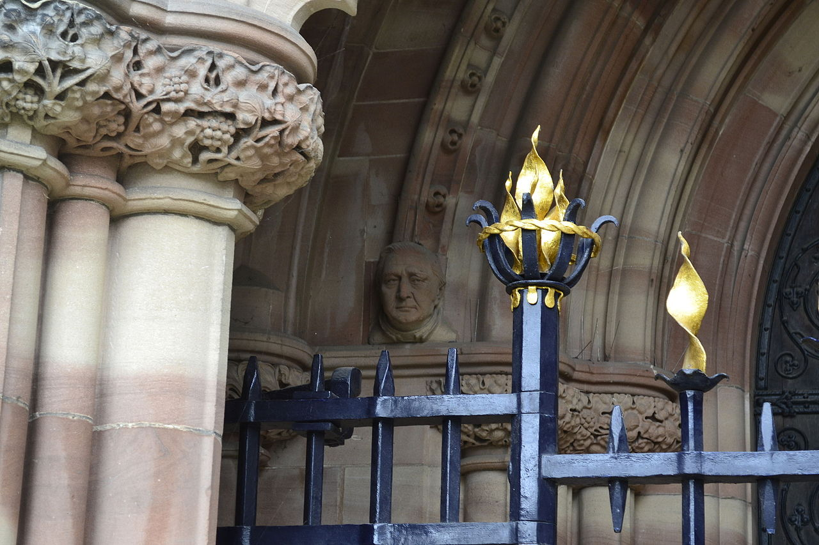
A corbel from the restored West Front of Hereford Cathedral

Slide 17
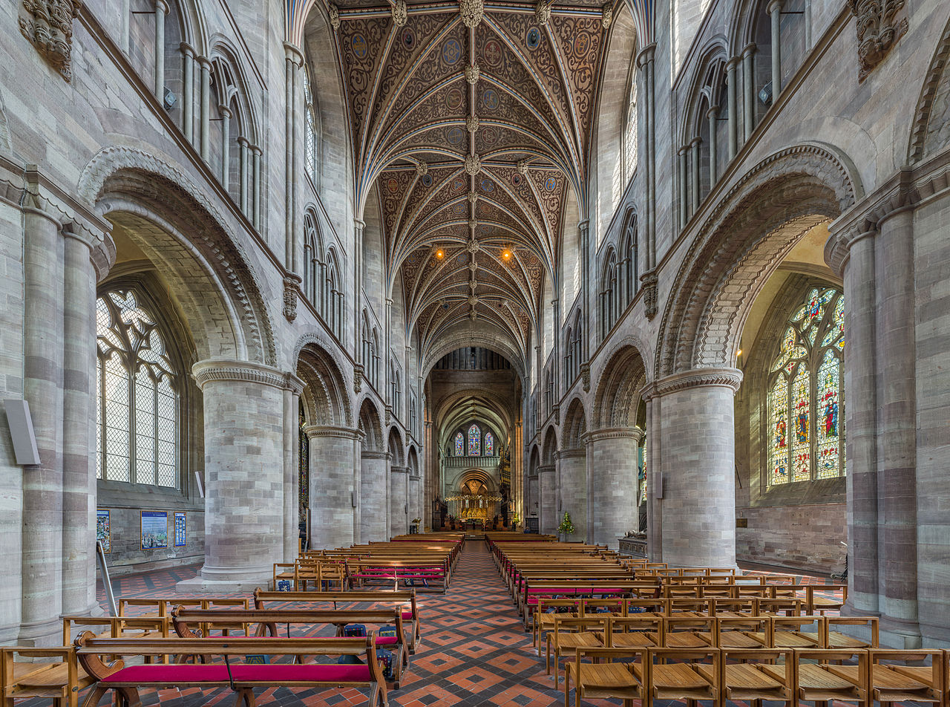
The nave, with Norman columns, viewed towards the choir

Slide 18
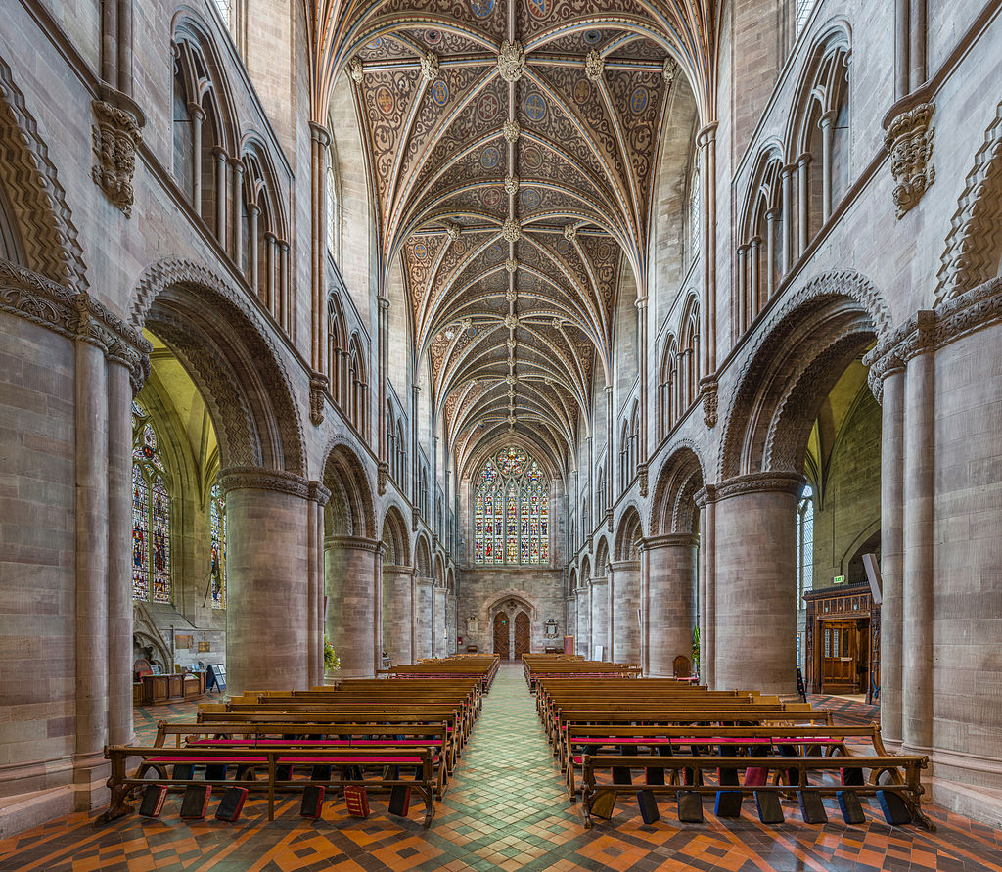
The nave looking west

Slide 19
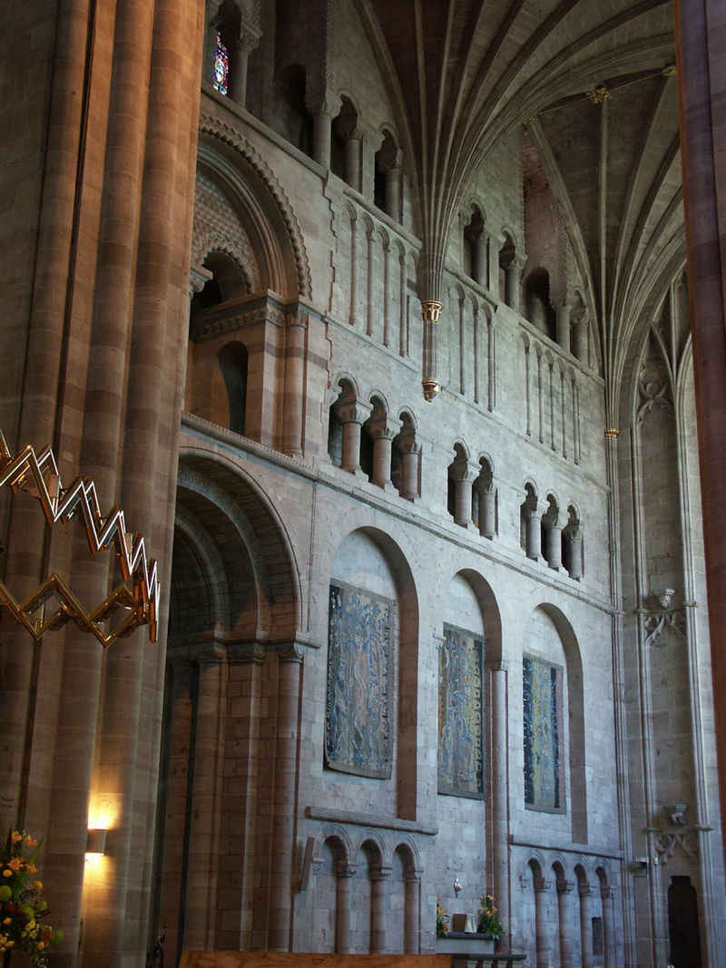
South transept

Slide 20
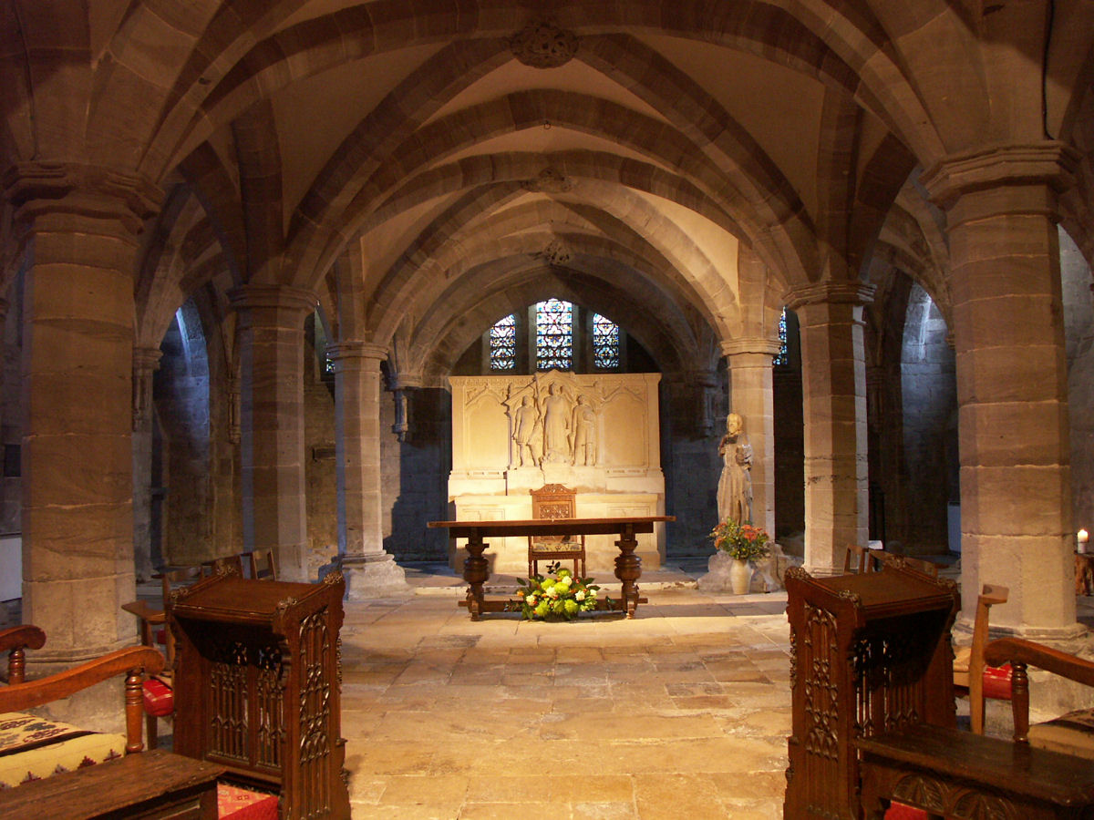
Crypt underneath the Lady Chapel

Slide 21
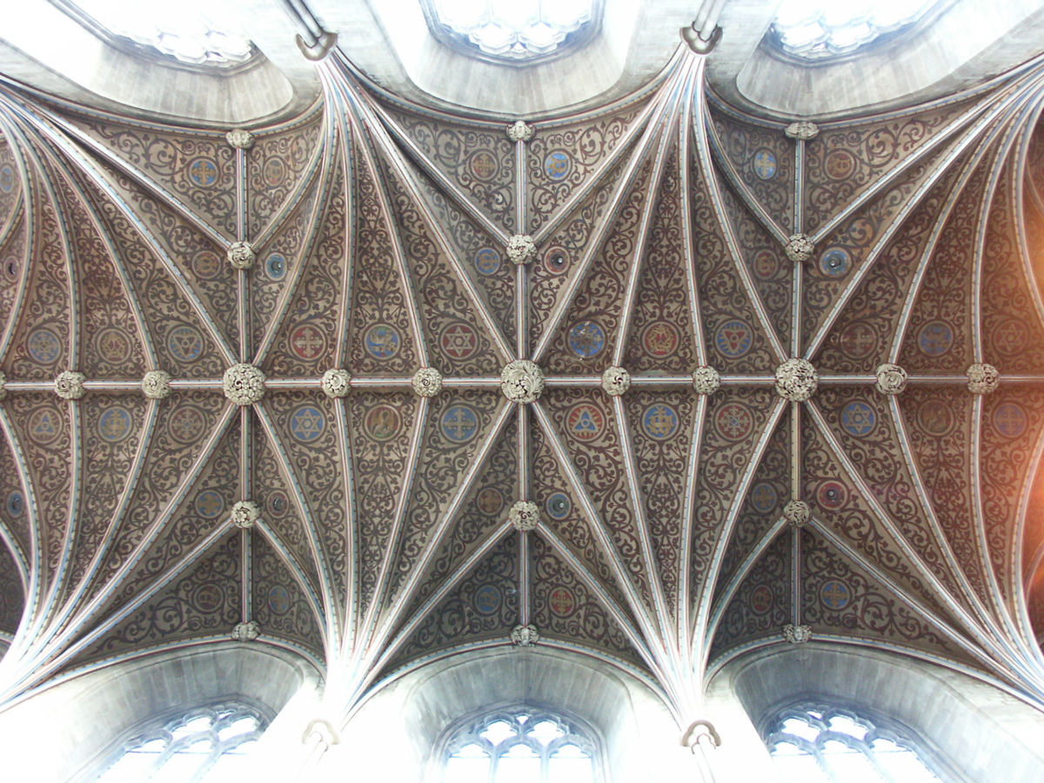
Ceiling bosses in the nave

Slide 22
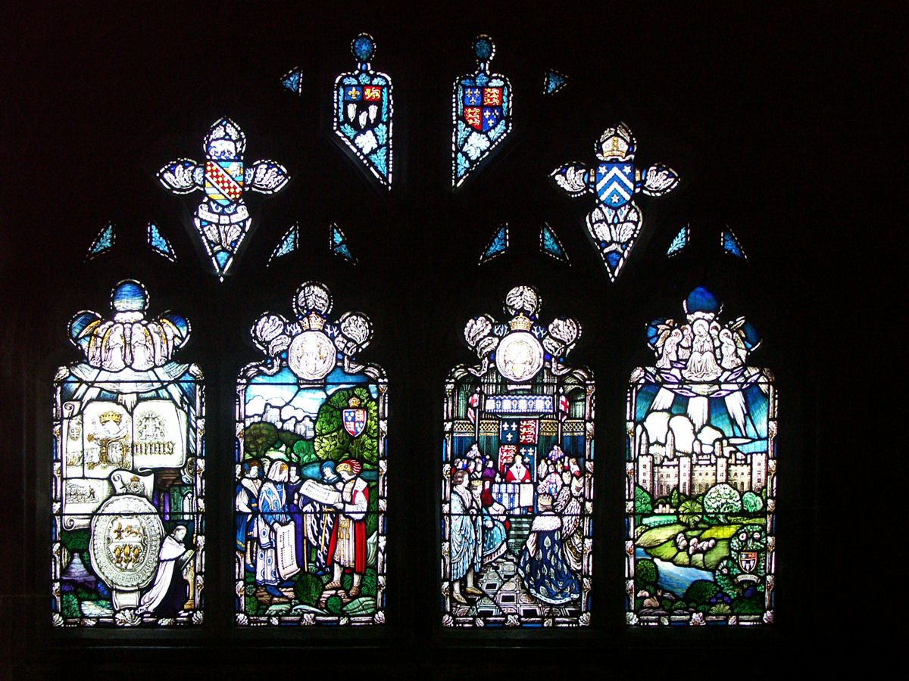
Stained glass windows

Slide 23
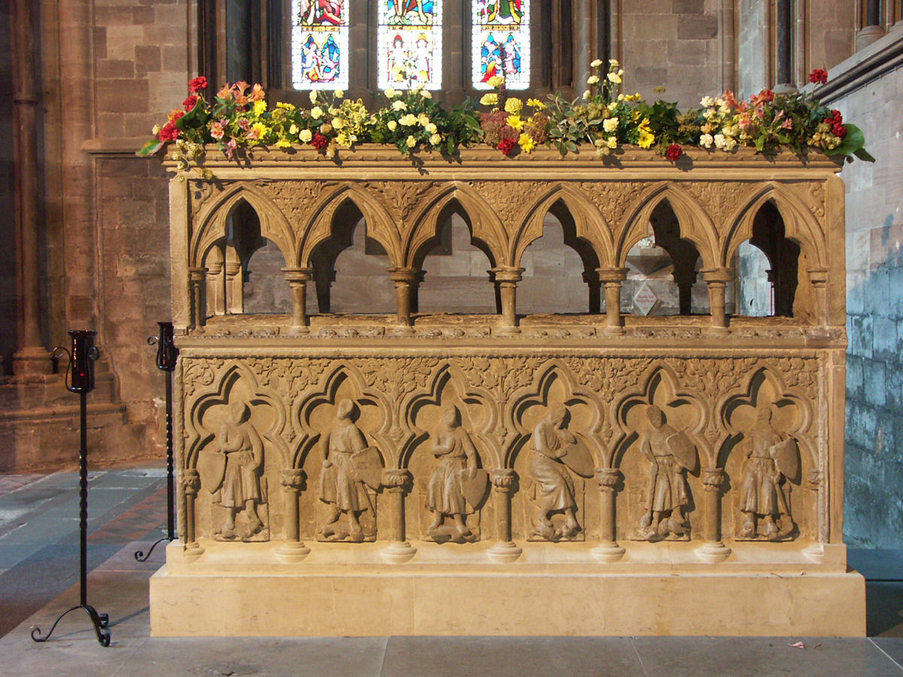
Tomb of Saint Thomas de Cantilupe

Slide 24
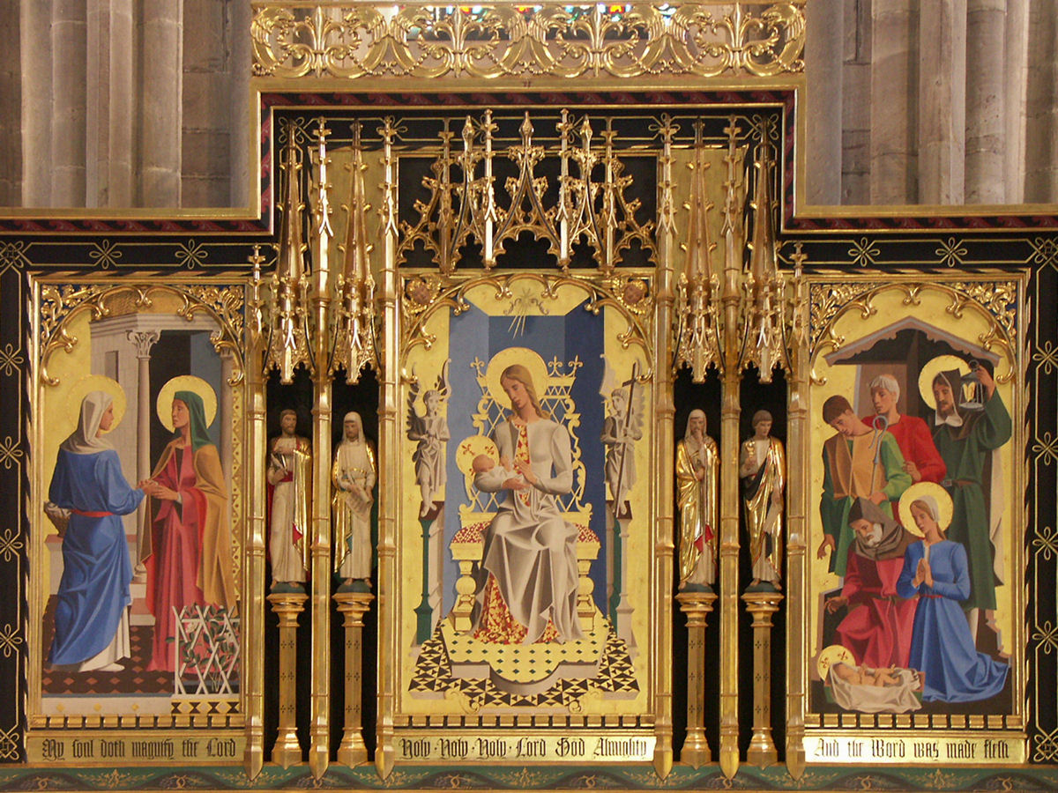
Lady Chapel Altar

Slide 25
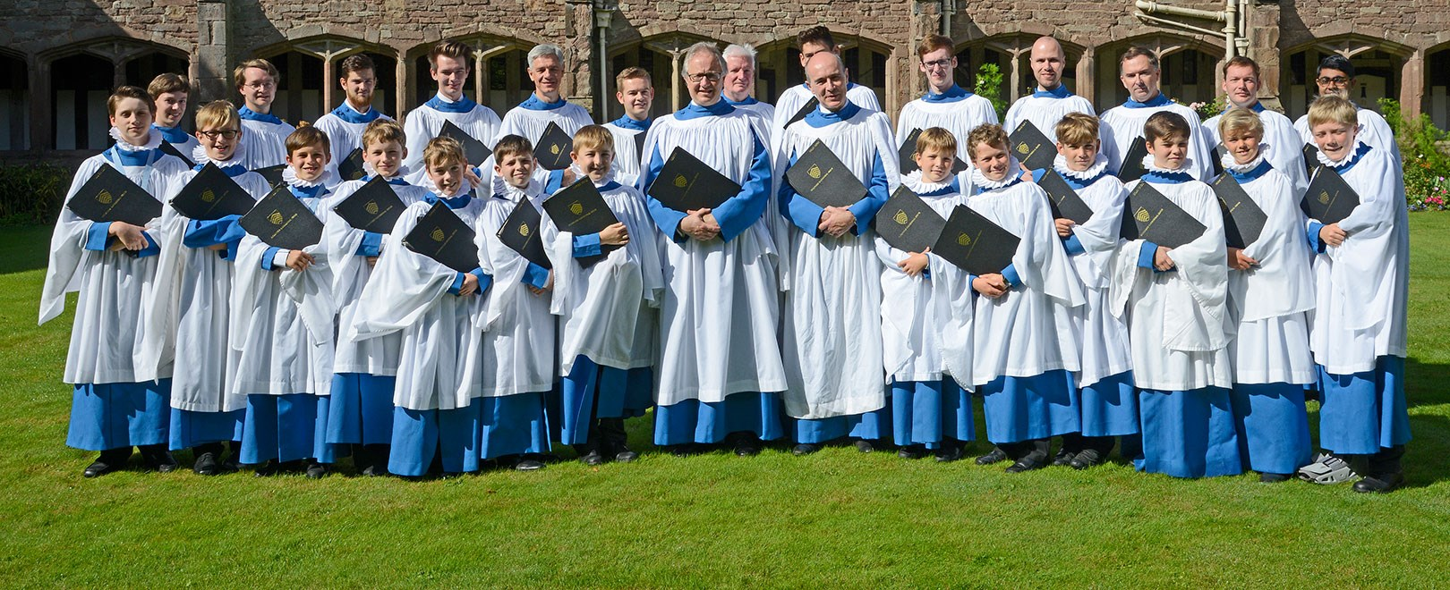

Slide 26
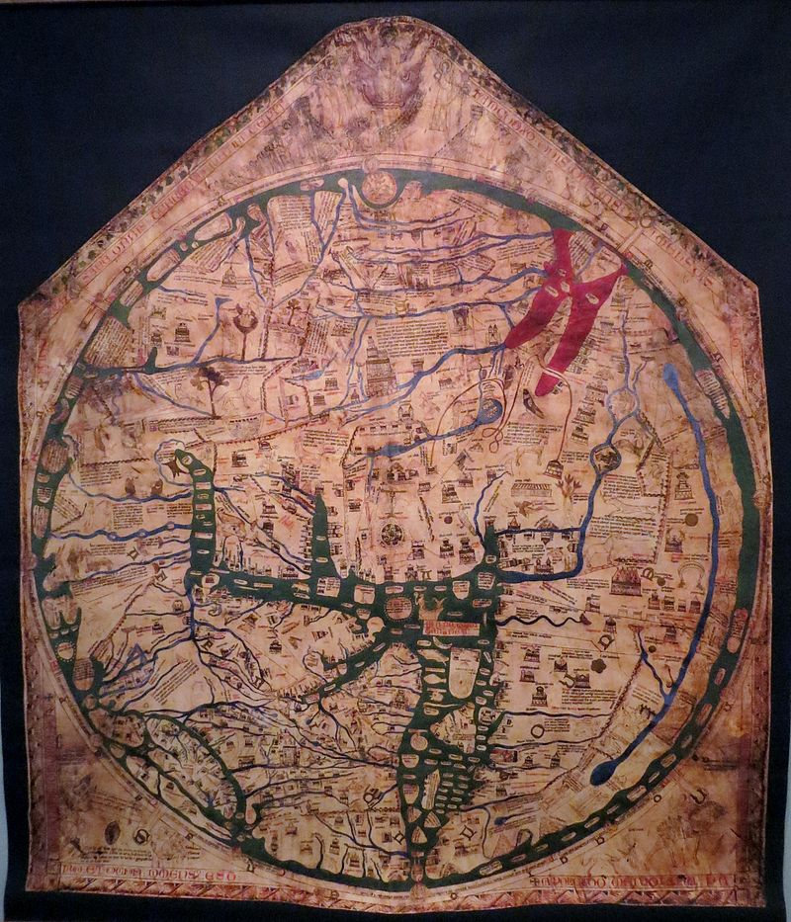
A replica of the Hereford Mappa Mundi, the 14th century world map that was originally located above the altar in Hereford Cathedral.

