Slide 1
ATTIVITA’ IN GALILEA 4
MATTEO, V,1-48, 6. 1-9, 14-34, VII 1-8, 21-29, VIII, 5-13, X, 1-14, , XI, 2-9, XII, 22-50, XIII, 1-30
MARCO, III, 13, IV, 29
LUCA, VI, 12-17, 20-49, VII, 1-26, 38-50, VIII, 1-21, XI, 14-28

Slide 2
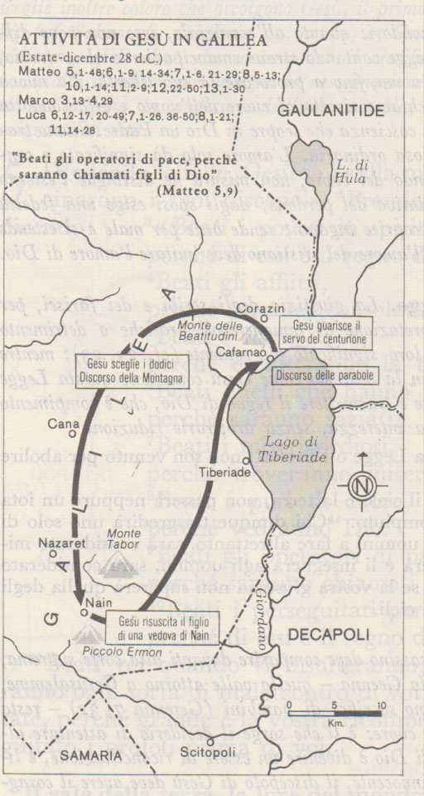
Estate-dicembre 28 d. Cr.

Slide 3
Cafarnao

