Slide 1
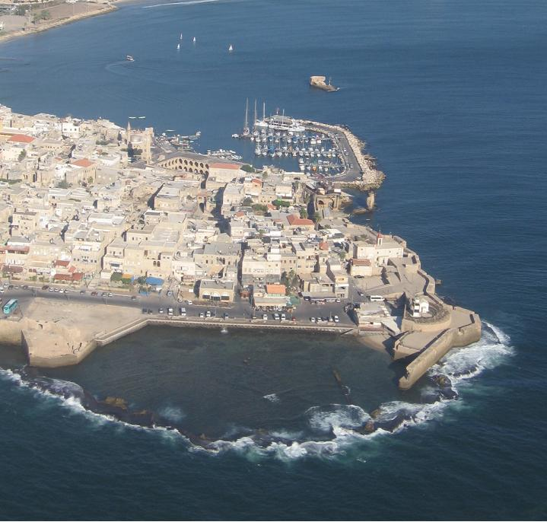

Slide 2
Accri, bastioni del porto crociato

Slide 12
Ottoman aqueduct to Acre at Kibbutz Lohamei HaGeta'ot

Slide 13
Remains of Crusader harbor

Slide 14
Old City of Acre

Slide 15
The Templar Tunnel

Slide 16
Old City of Acre, 1878 by Félix Bonfils

Slide 17
Port of Acre

Slide 18
Interior of Acre prison, circa 1938

Slide 19
Acre city hall

Slide 20
Baha'i pilgrims often visit Acre

Slide 21
Acre Railway Station

Slide 22
Acre sea wall

Slide 23
Khan al-Umdan in the old city of Acre

Slide 24
Al-Jazzar Mosque

Slide 25
Refectory of the Hospitaller fortress

Slide 26
Baha'i shrine outside Acre, Bahji mansion

Slide 27
Carronade near the Old City

