Slide 1
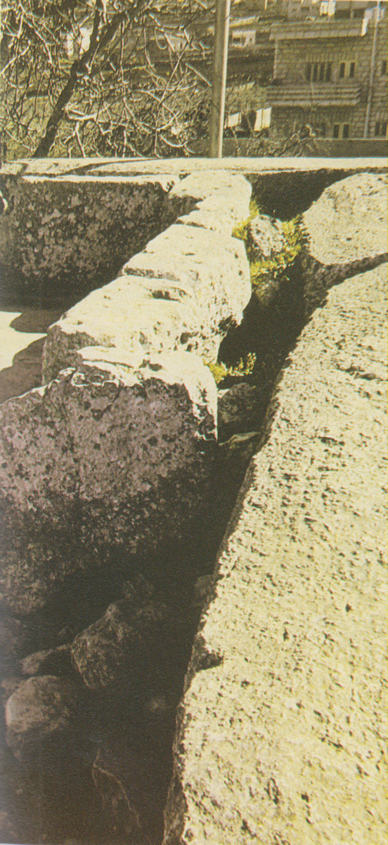
Mambre, resti erodiani

Slide 2
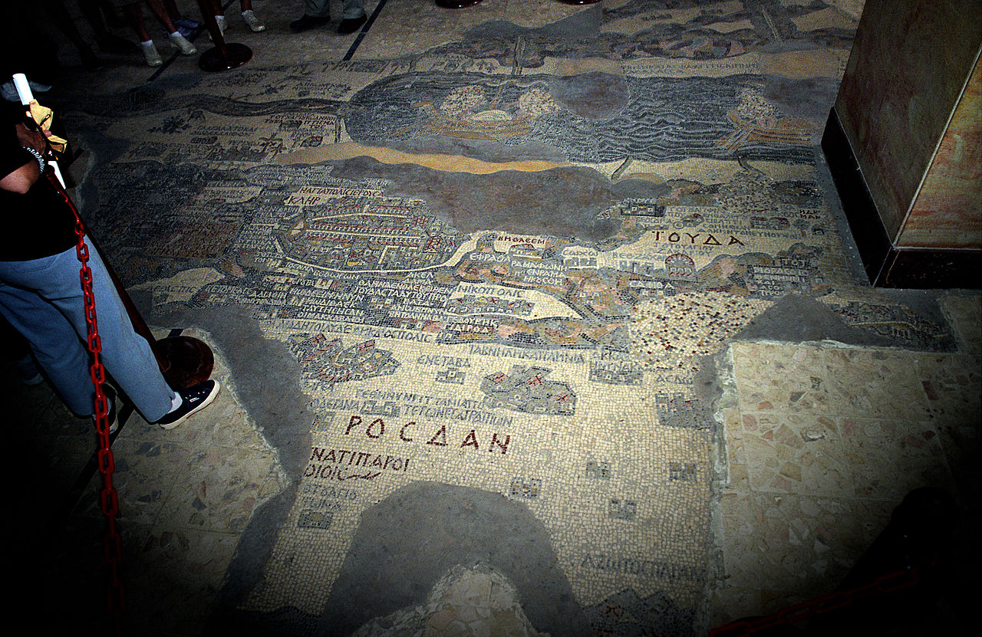
the Madaba Mosaic Map - the Greek Orthodox Basilica of Saint George

Slide 3
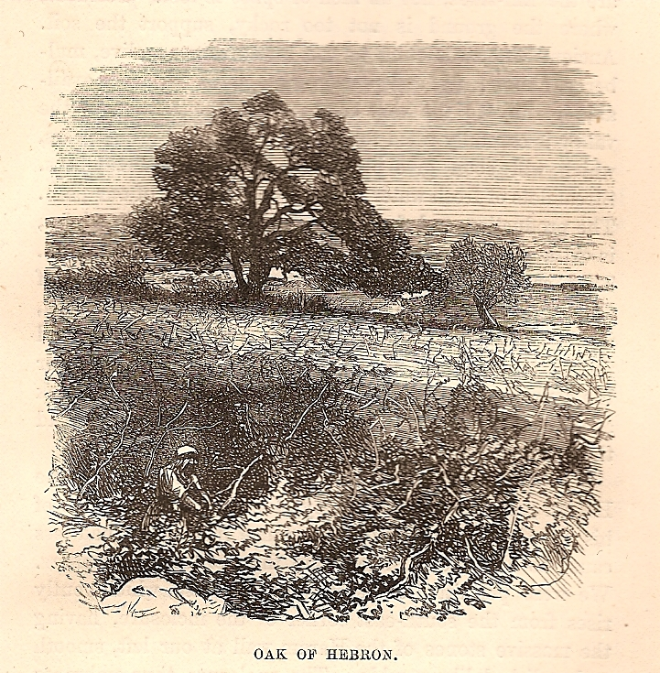
Abraham´s Oak, in Tristram, 1865

