Slide 1
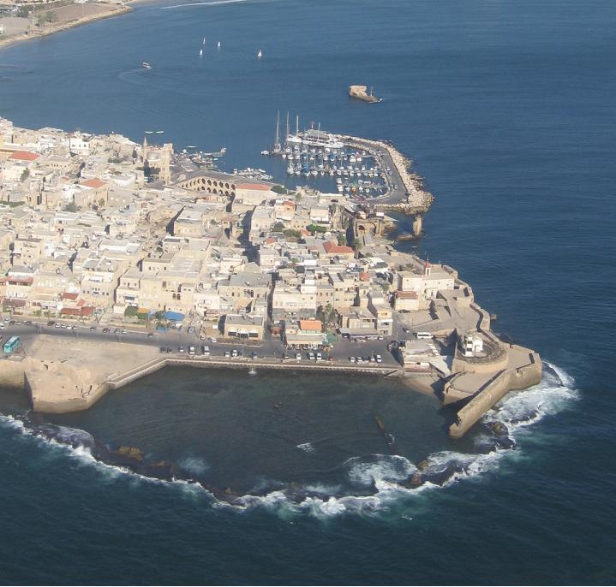

Slide 2
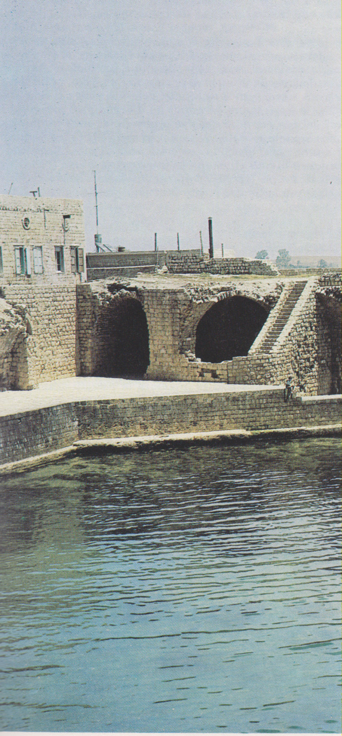
Accri, bastioni del porto crociato

Slide 3
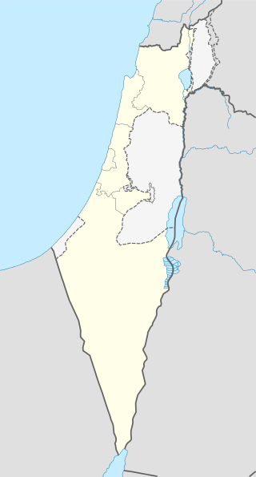

Slide 4
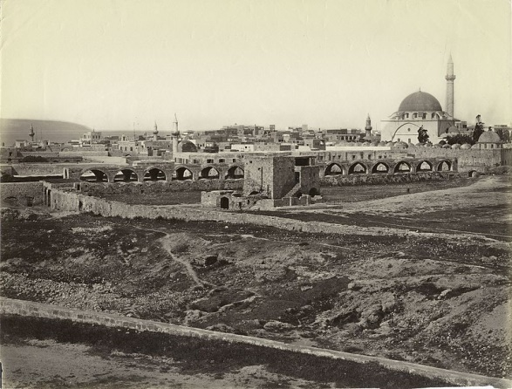

Slide 5
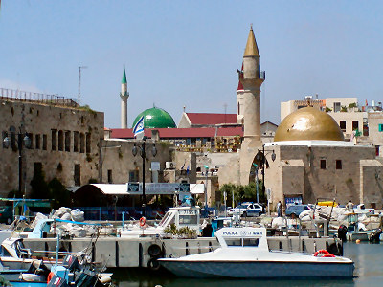

Slide 6
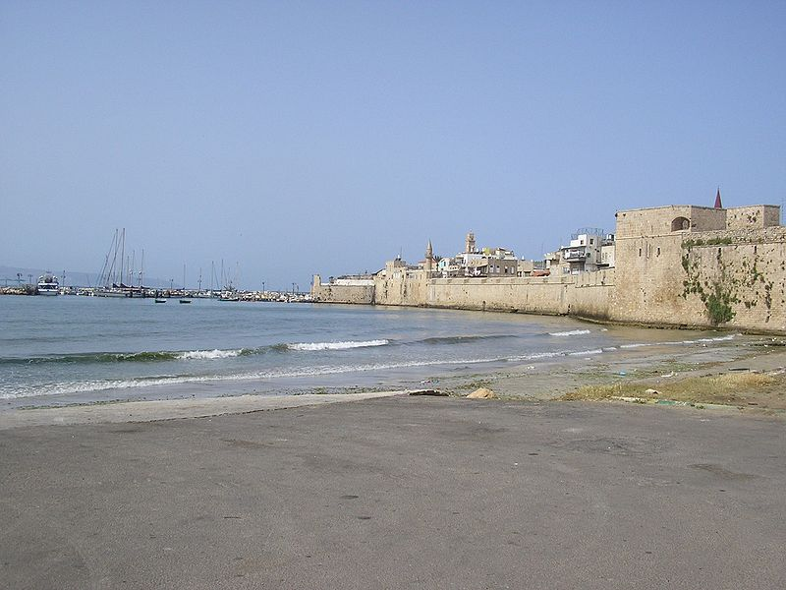

Slide 7
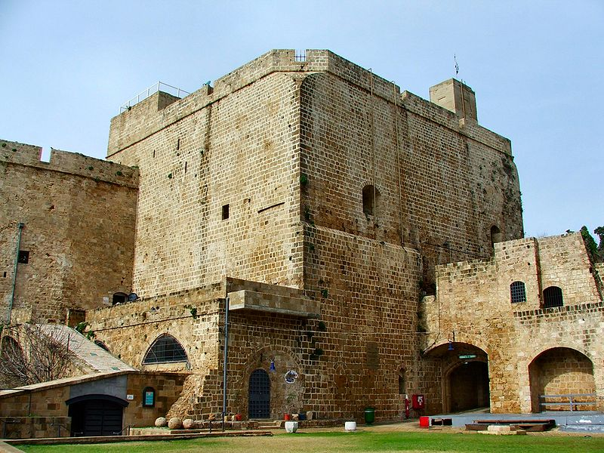

Slide 8
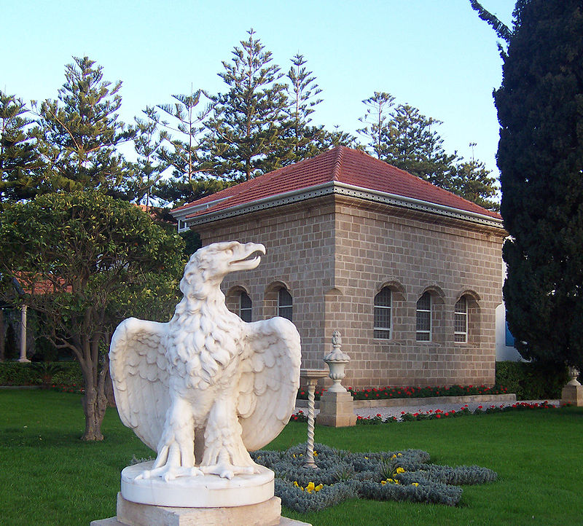

Slide 9
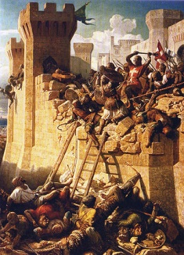

Slide 10
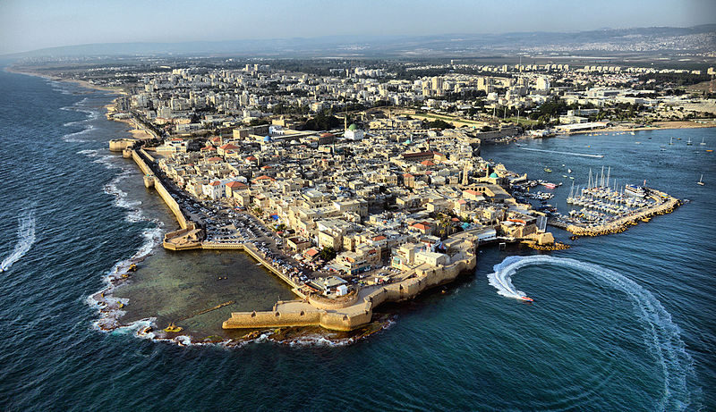

Slide 11
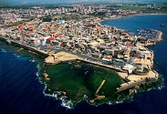

Slide 12
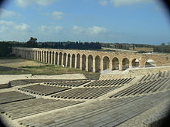
Ottoman aqueduct to Acre at Kibbutz Lohamei HaGeta'ot

Slide 13
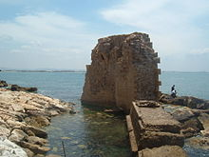
Remains of Crusader harbor

Slide 14

Old City of Acre

Slide 15
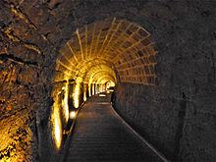
The Templar Tunnel

Slide 16
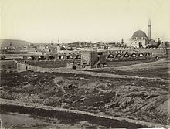
Old City of Acre, 1878 by Félix Bonfils

Slide 17
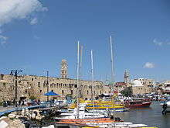
Port of Acre

Slide 18
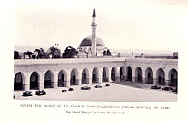
Interior of Acre prison, circa 1938

Slide 19
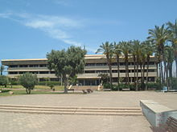
Acre city hall

Slide 20

Baha'i pilgrims often visit Acre

Slide 21
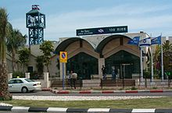
Acre Railway Station

Slide 22
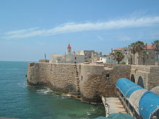
Acre sea wall

Slide 23
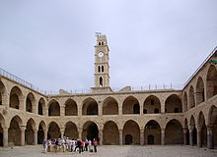
Khan al-Umdan in the old city of Acre

Slide 24
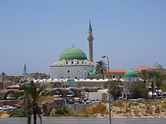
Al-Jazzar Mosque

Slide 25
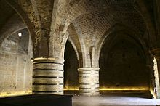
Refectory of the Hospitaller fortress

Slide 26
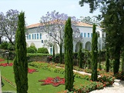
Baha'i shrine outside Acre, Bahji mansion

Slide 27
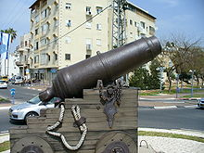
Carronade near the Old City

