Slide 1
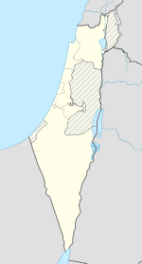

Slide 2
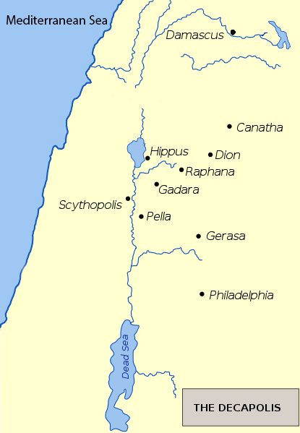

Slide 3
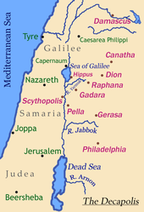

Slide 4
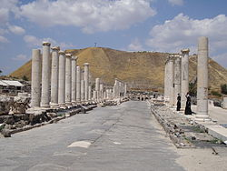
Scitopoli, Bet Shean, Roman Cardo in Beit She'an National Park

Slide 5
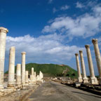

Slide 6
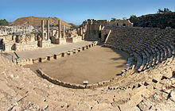
Beit She'an theatre

Slide 7
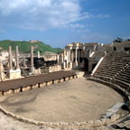

Slide 8
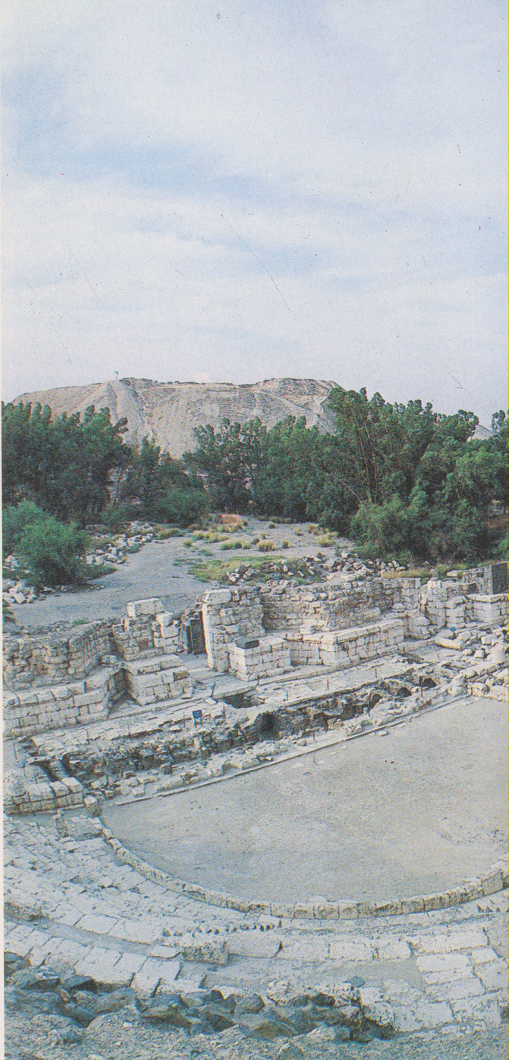
Bet Shean, resti del teatro romano

Slide 9
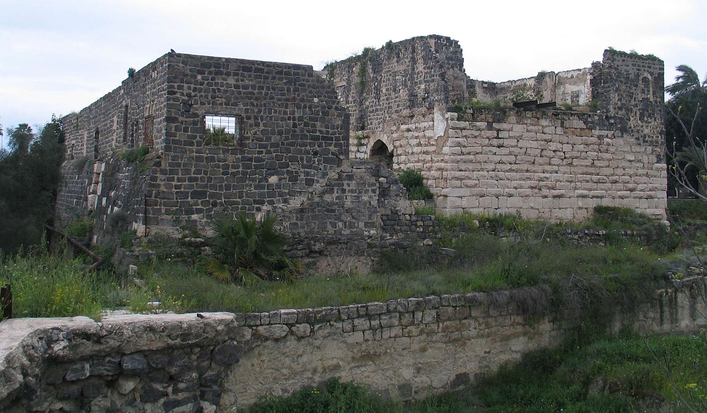
Crusader castle with moat and inner tower.

Slide 10
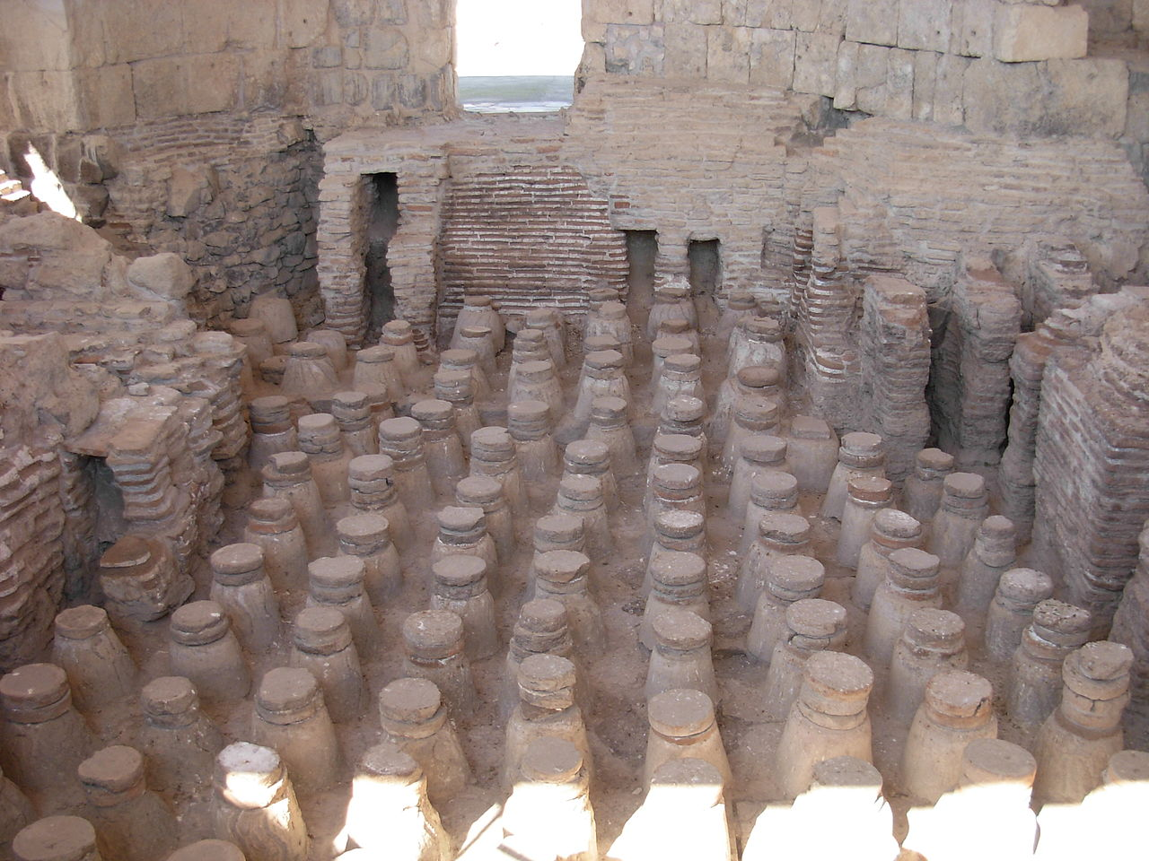
Roman baths

Slide 11
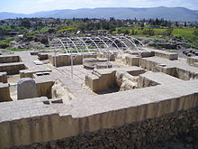
BetShe'an - an ancient house of Egyptian governor

Slide 12
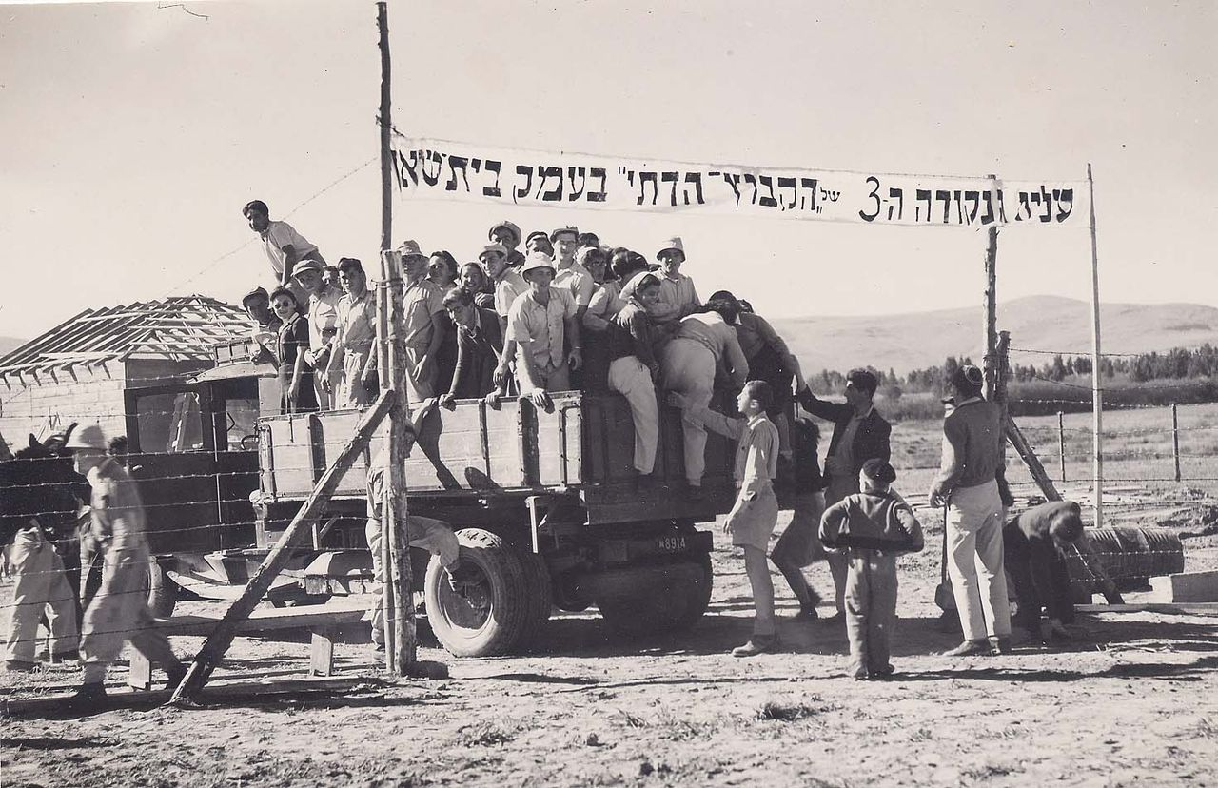
Pioneers of Kibbutz Ein Hanatziv settle in Bet She'an, 1946

Slide 13
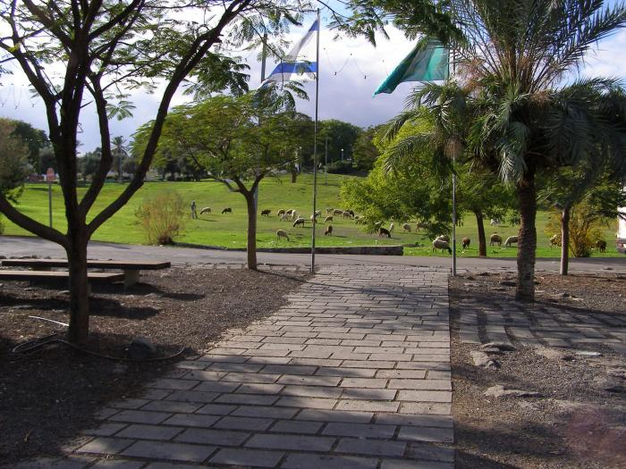
Beit She'an park

Slide 14
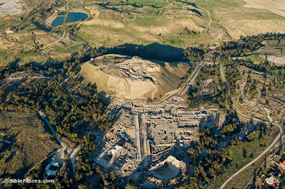

Slide 15
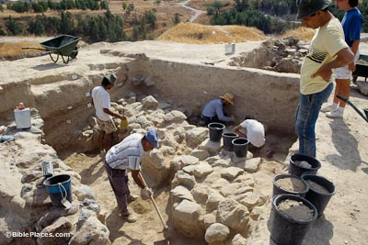

Slide 16
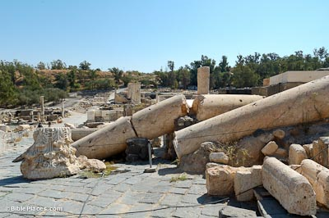

Slide 17
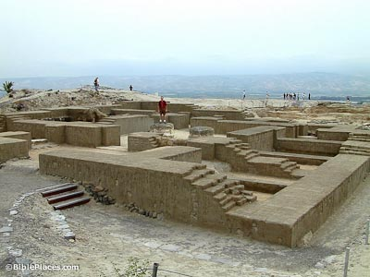

Slide 18


Slide 19
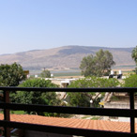
Bet Shean, Monte Gelboe

