Slide 1
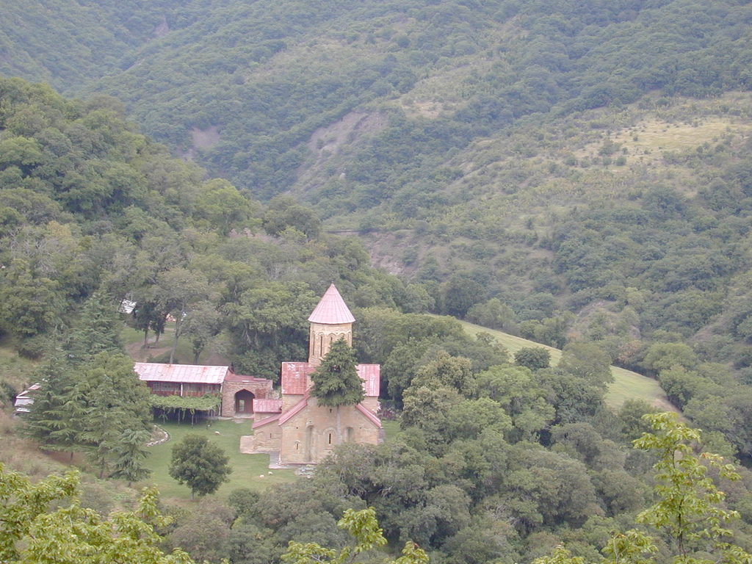

Slide 13
Betania

