Slide 1
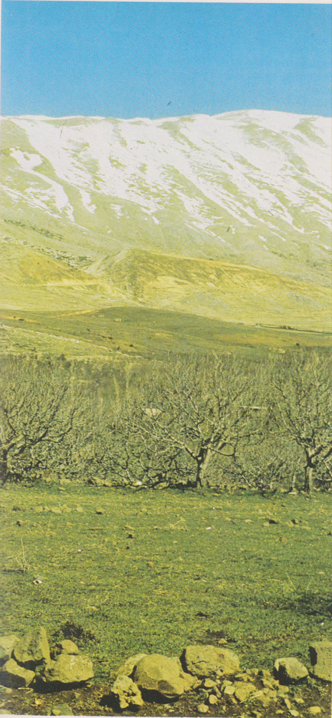
Monte Hermon-

