Slide 1
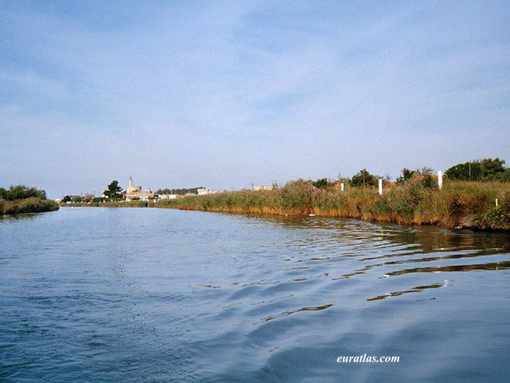
Aigues-Mortes in the Camargue

Slide 2
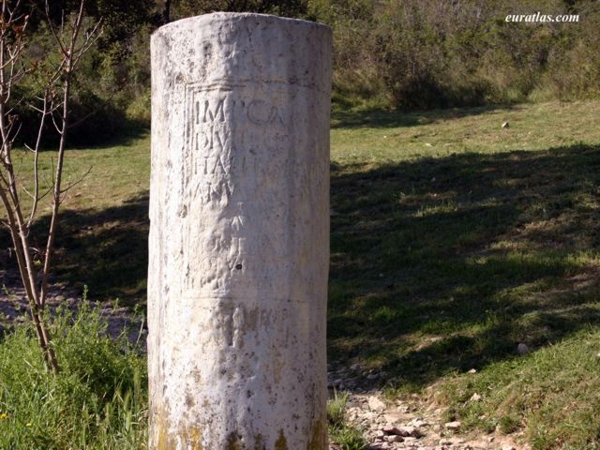
A Roman Marker Stone at Ambrussum

Slide 3
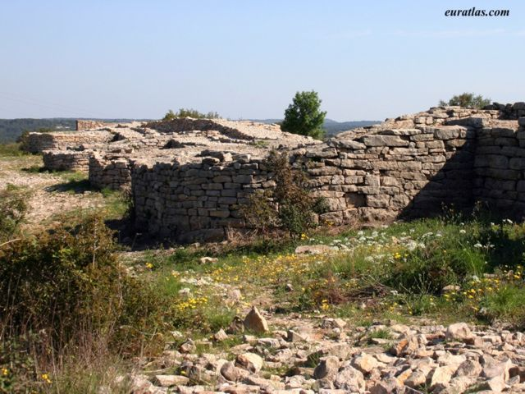
The Gallic Oppidum of Ambrussum, near Lunel

Slide 4
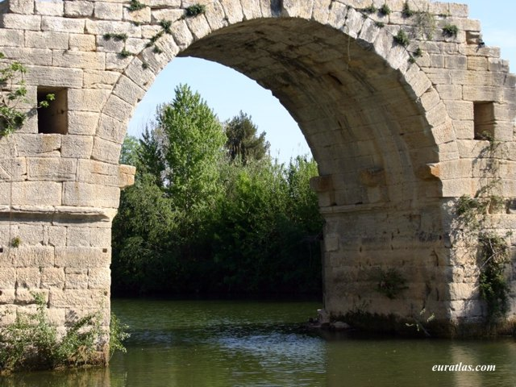
The Roman Bridge at Ambrussum

Slide 5
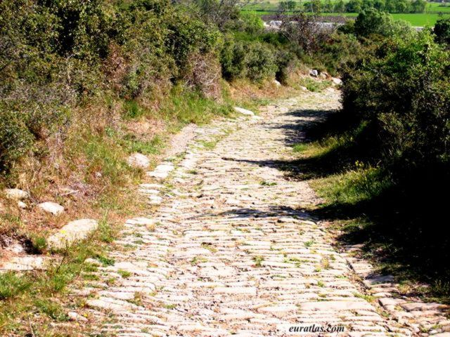
The Roman Road at Ambrussum

Slide 6
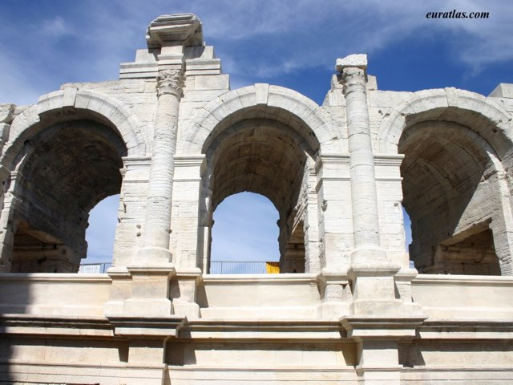
The Roman Amphitheater of Arles

Slide 7
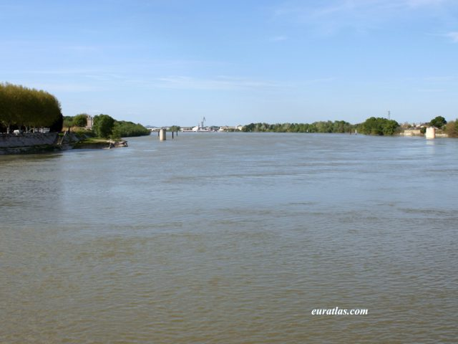
The Rhône River in Arles

Slide 8
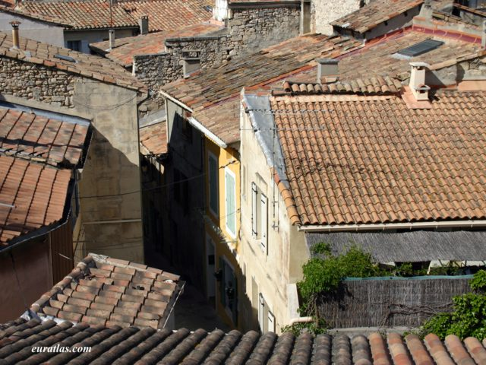
Roofs of Arles

Slide 9
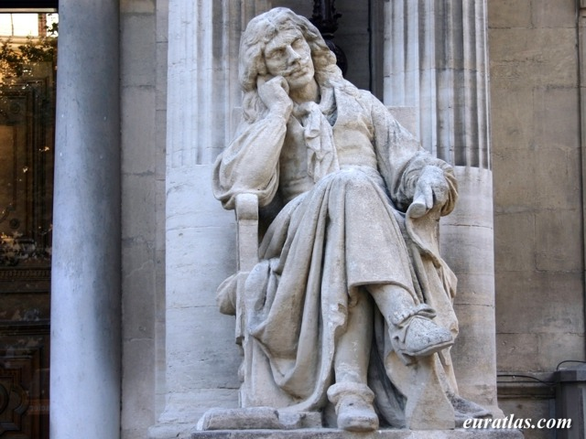
Avignon, the Statue of Molière

Slide 10
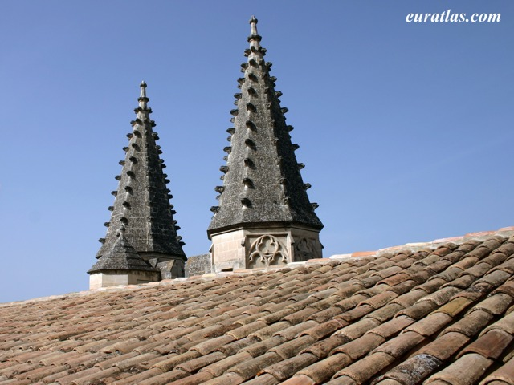
Avignon, Turrets of the Champeaux Gate

Slide 11
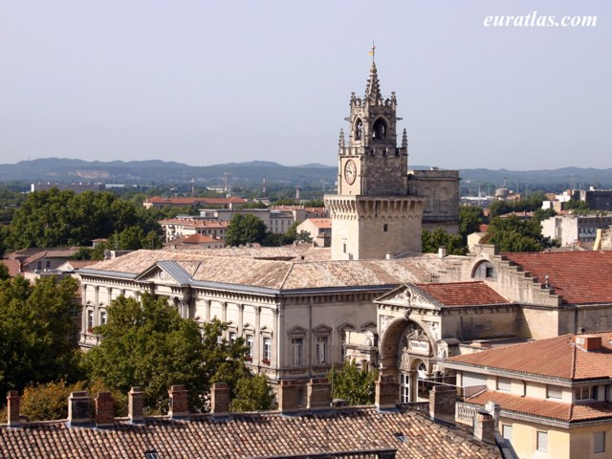
The Town Hall of Avignon

Slide 12
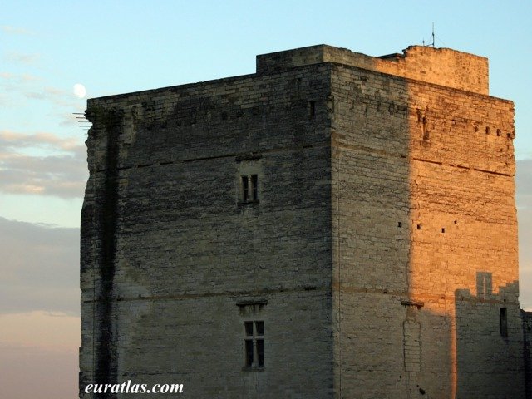
The Moon over the Palais des Papes

Slide 13
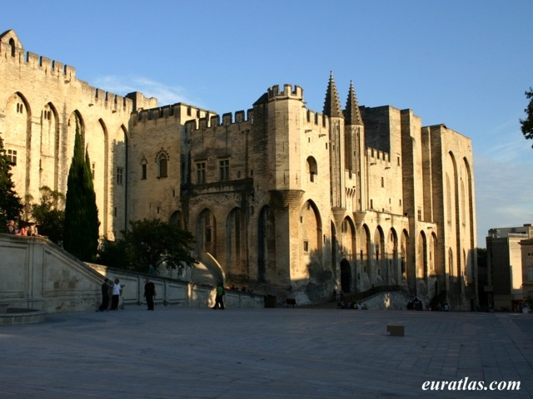
The Palais des Papes in Avignon

Slide 14
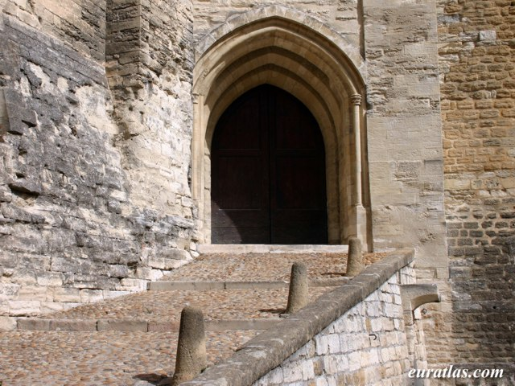
Palais des Papes, Gate of the Trésor Bas

Slide 15
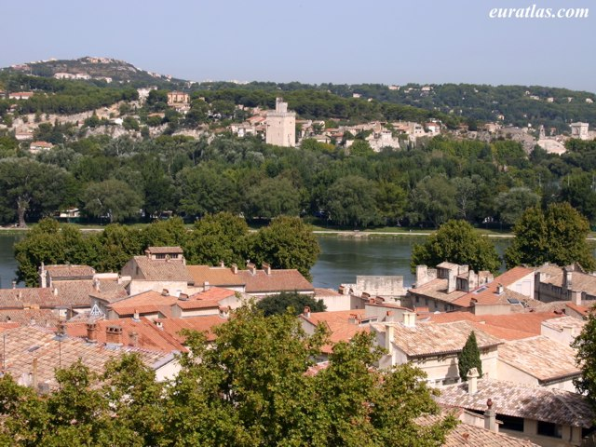
The Tower Philippe le Bel, Villeneuve-lès-Avignon

Slide 16
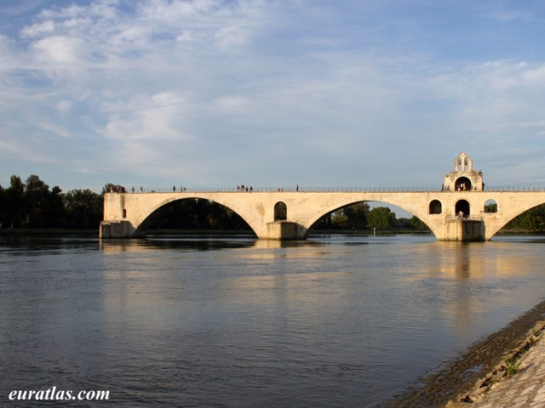
The Pont d'Avignon

Slide 17
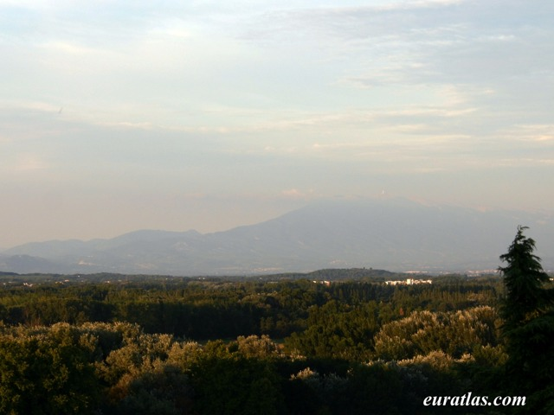
Mont Ventoux from Avignon

